Slide 1
Breast

Slide 2
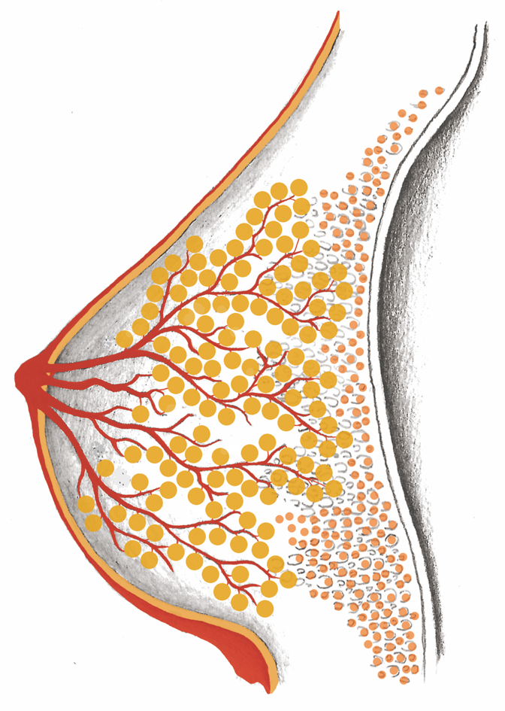
Breast Overview

Slide 3
Distribution Frequency of Breast Cancer

Slide 4
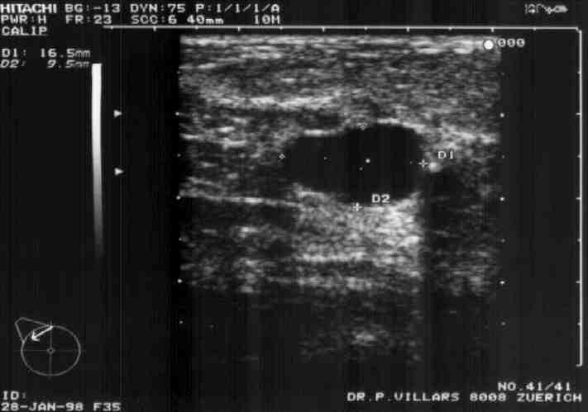
Uncertain Diagnosis: “Benign” Cyst 9 x 16 mm

Slide 5
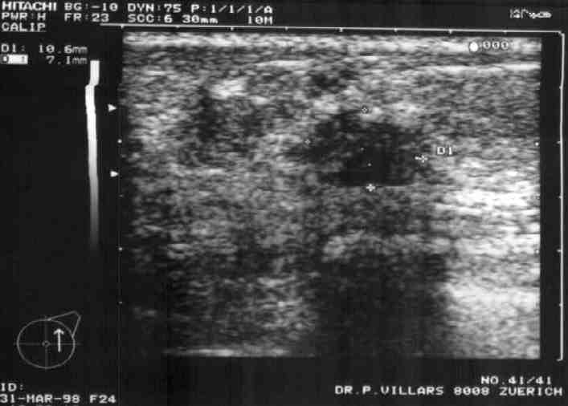
Uncertain Diagnosis: “Breast Cancer” 5 x 6 mm

Slide 6
Uncertain Diagnosis: “Dense Glandular Tissue”

Slide 7
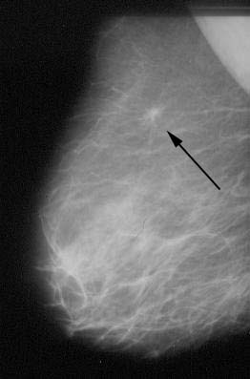
So small, and already
diagnosed:
“Early-stage breast
cancer, only
discovered
thanks to
mammography”

Slide 8
X-ray: “Lumps” – Lactiferous Ducts = DCIS

Slide 9
X-ray: Lactiferous Ducts – Nodes = DCIS

Slide 10
Mammary Glands

Slide 11
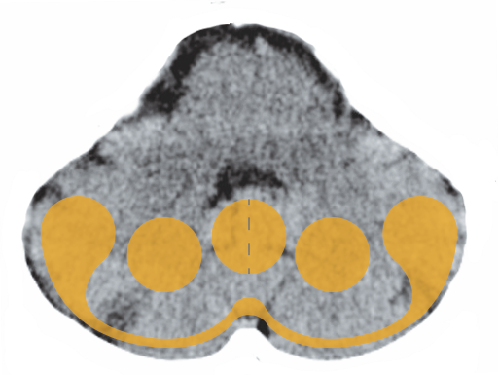
Cerebellum – Mammary Glands

Slide 12
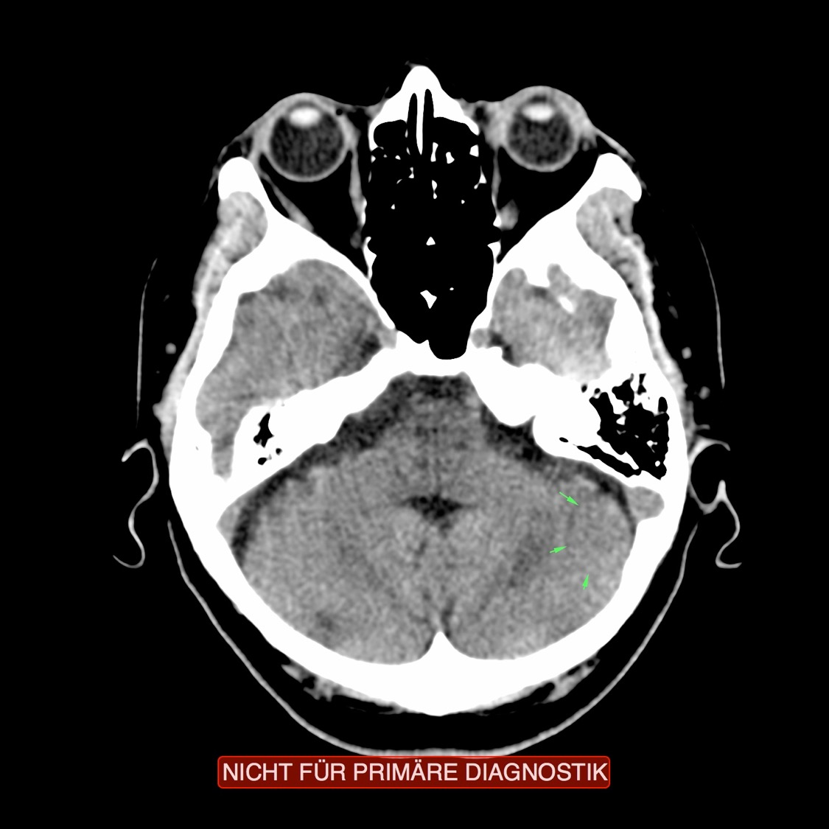
CT: Mammary Glands in the Cerebellum,
Partially Active

Slide 13
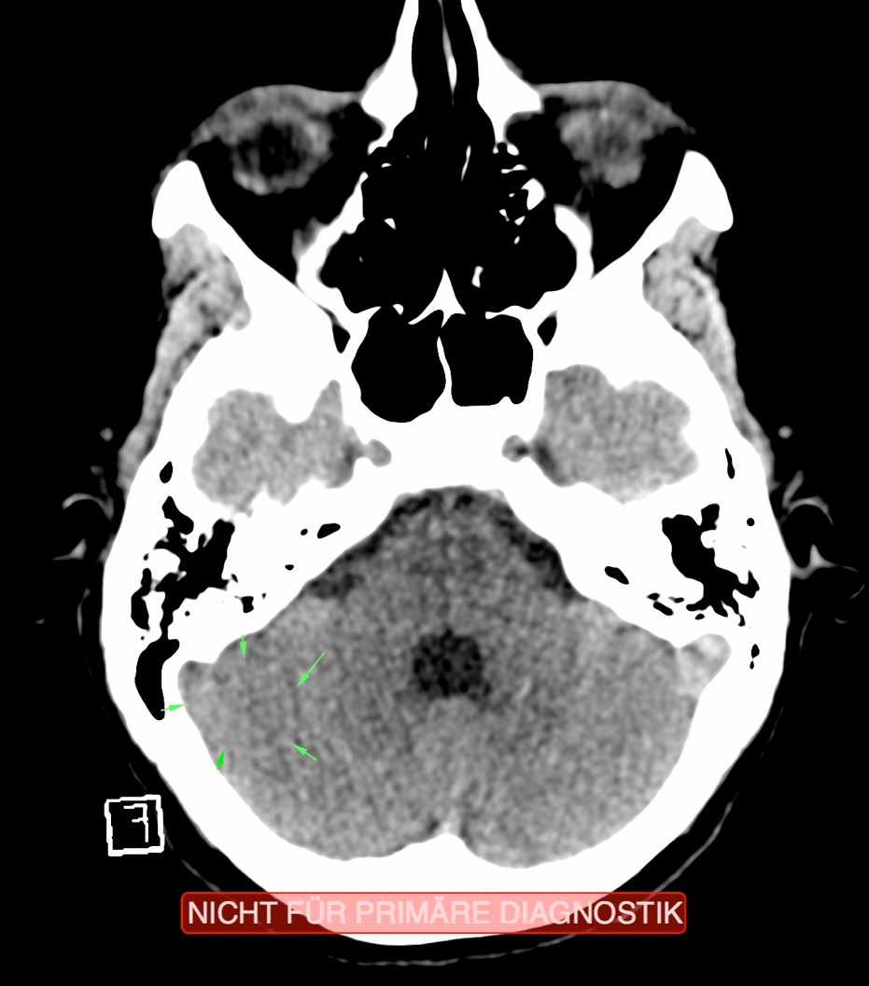
CT: Mammary Glands in the Cerebellum,
Old, Scarred

Slide 14
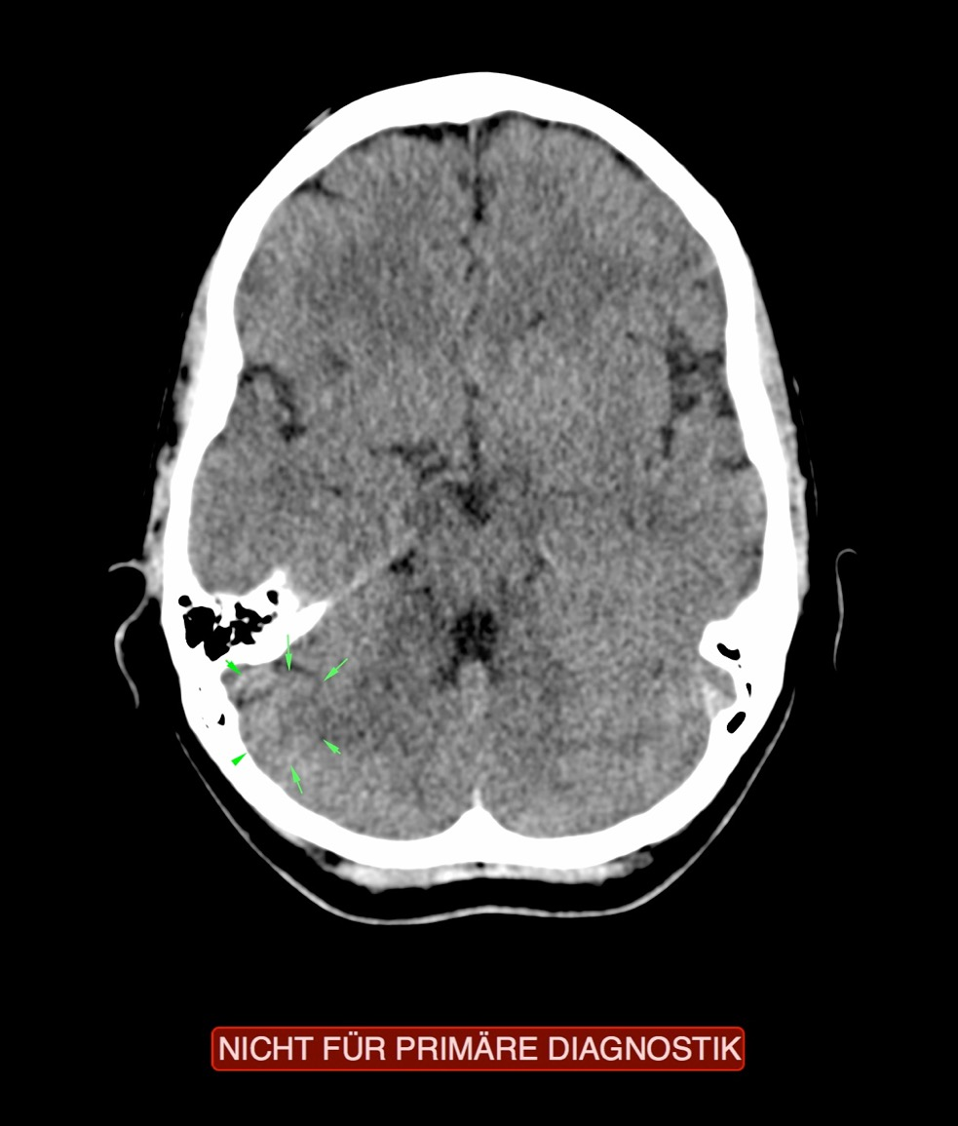
CT: Mammary Glands in the Cerebellum,
Repair Phase

Slide 15
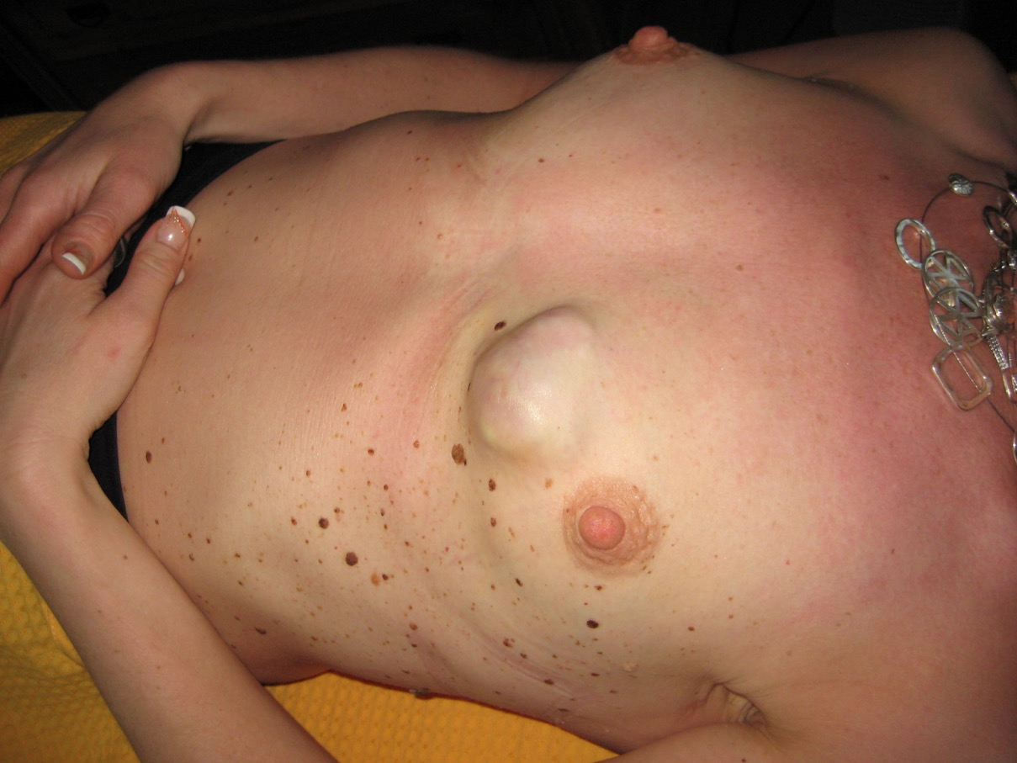
Case Example

Slide 16
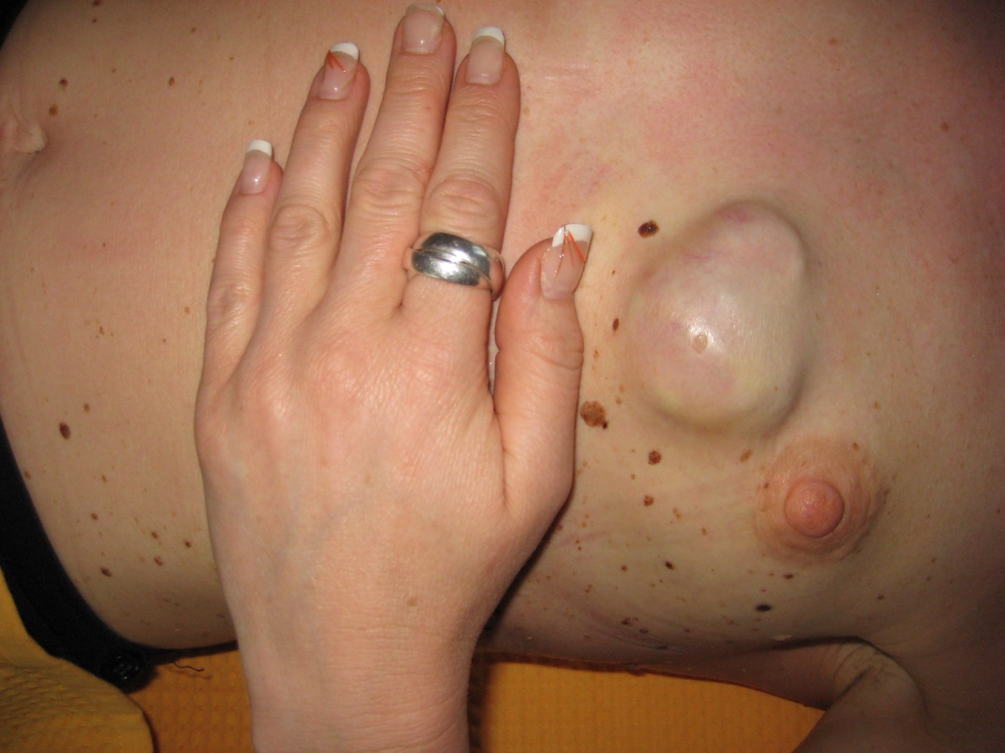
Case Example

Slide 17
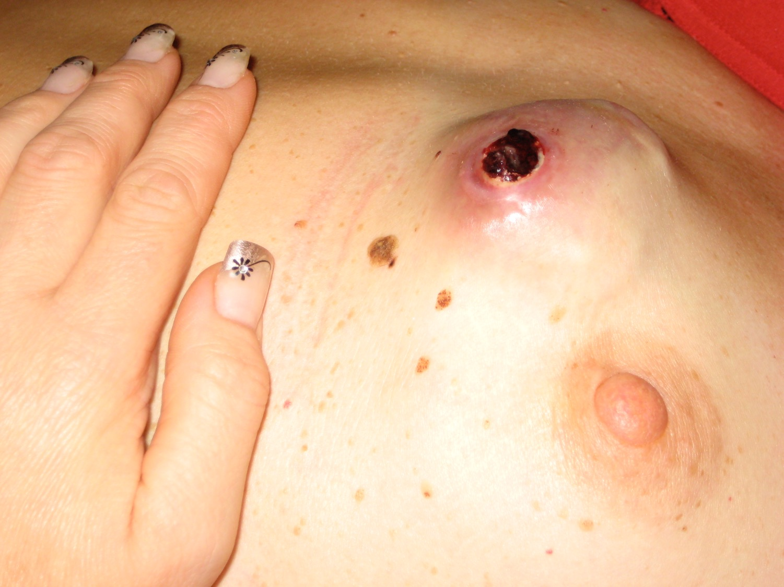
Fallbeispiel
Case Example

Slide 18
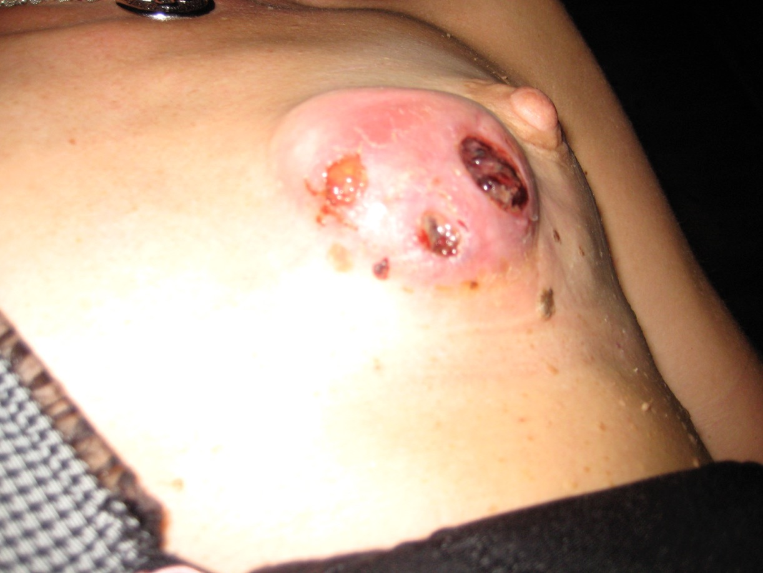
Case Example

Slide 19
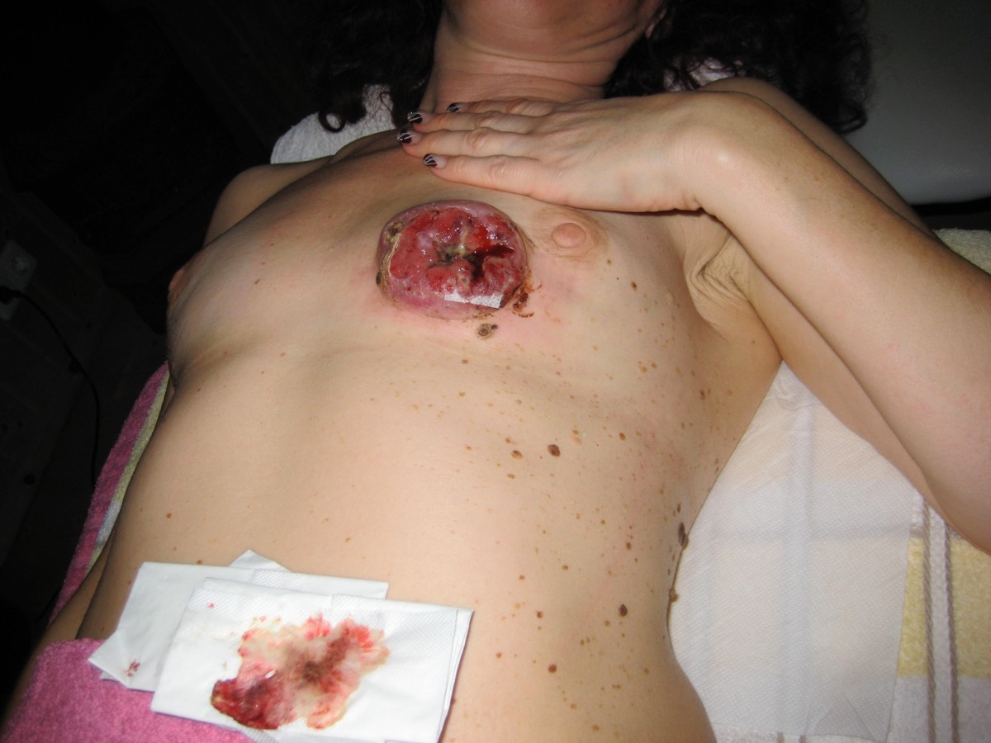
Case Example

Slide 20
Case Example

Slide 21
Breast - Lactiferous Ducts

Slide 22
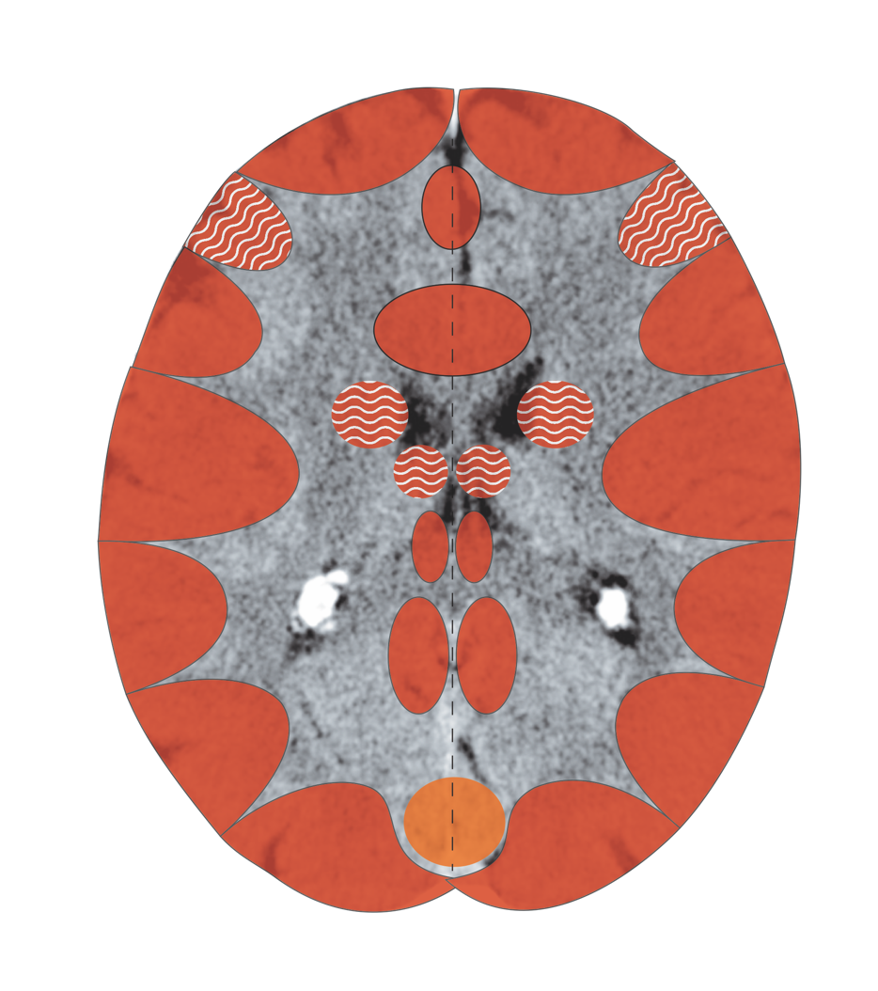
Cerebral Cortex Excretory Ducts – Sensory
Notes:
22

Slide 23
Lactiferous Excretory Ducts – Sensory
Haut – Sensorik - Großhirnrinde
Sensorik

Slide 24
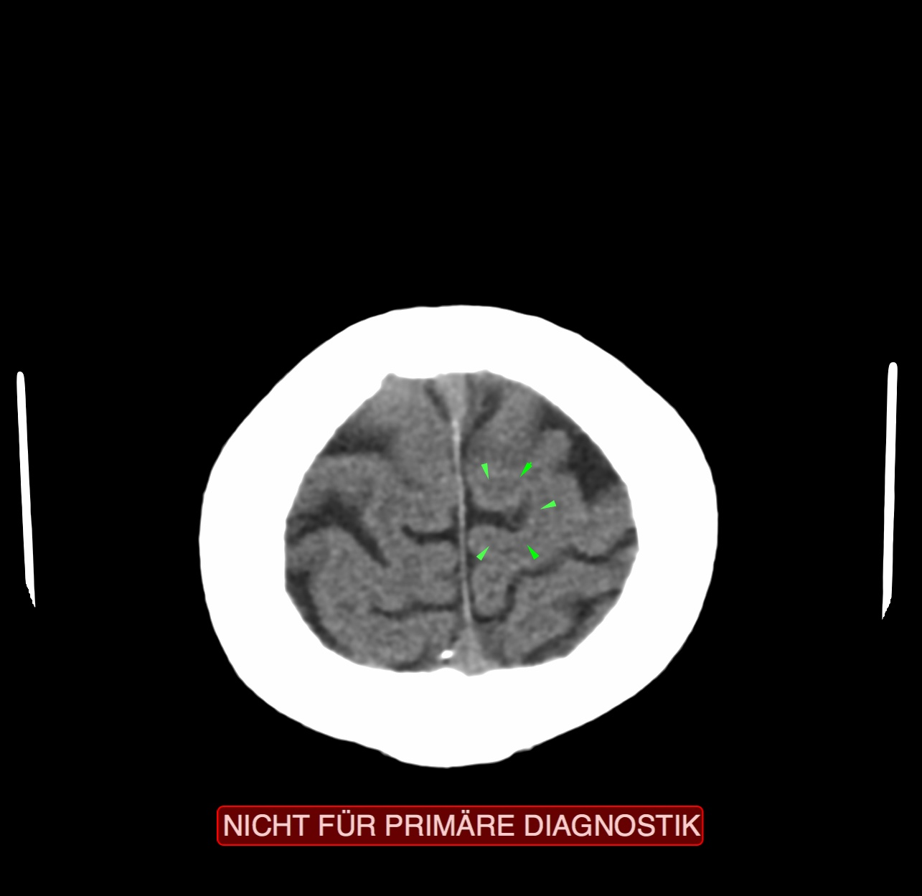
CT: Breast Lactiferous Ducts, Recurring C.

Slide 25
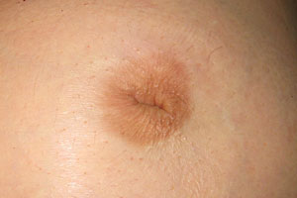
Inverted Nipple – Indication of Active Lactation

Slide 26
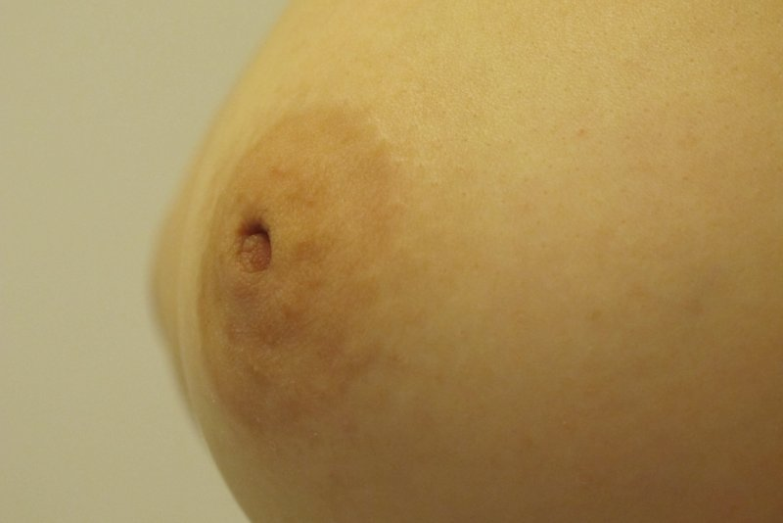
Inverted Nipple – Indication of Active Lactation

Slide 27
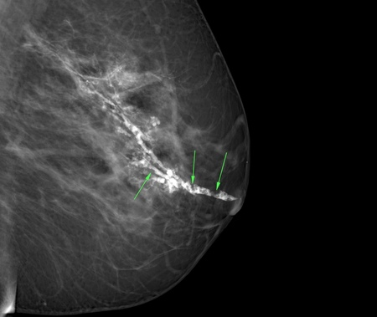
Micro Calcifications – Indication of Completed
SBS of the Lactiferous Ducts

Slide 28
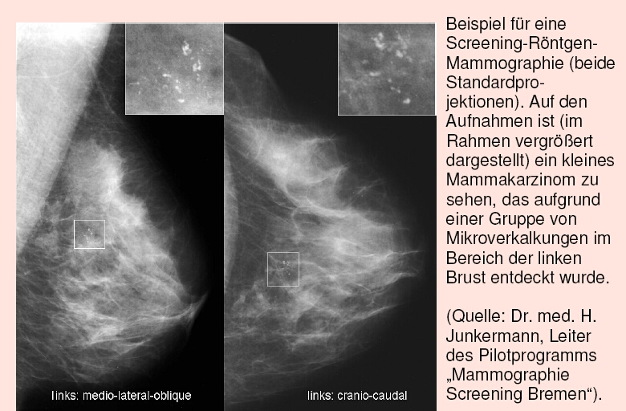
Example of a x-ray mammography screening (both standard projections). On the image (enlarged view in the inset), a small breast carcinoma can be seen. It was discovered due to a group of micro calcifications in an area of the left breast.

