Slide 1
Bladder Urethra

Slide 2
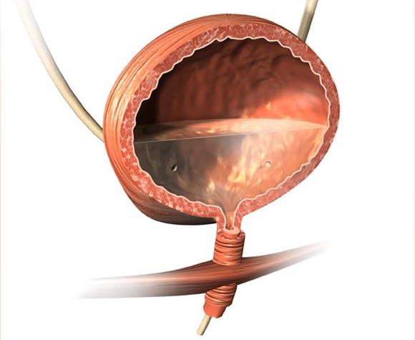
Bladder

Slide 3
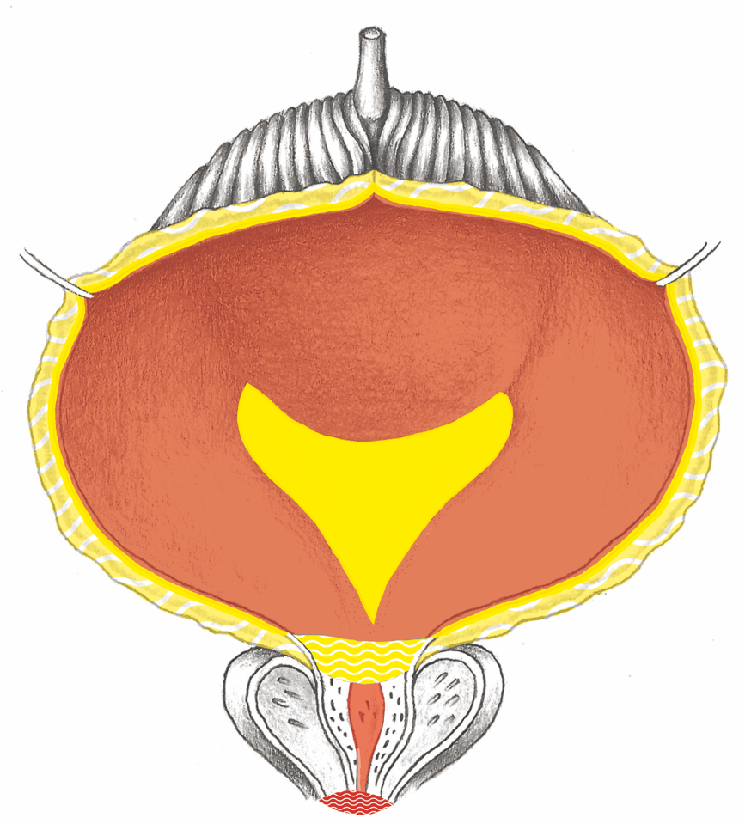
Bladder Overview

Slide 4
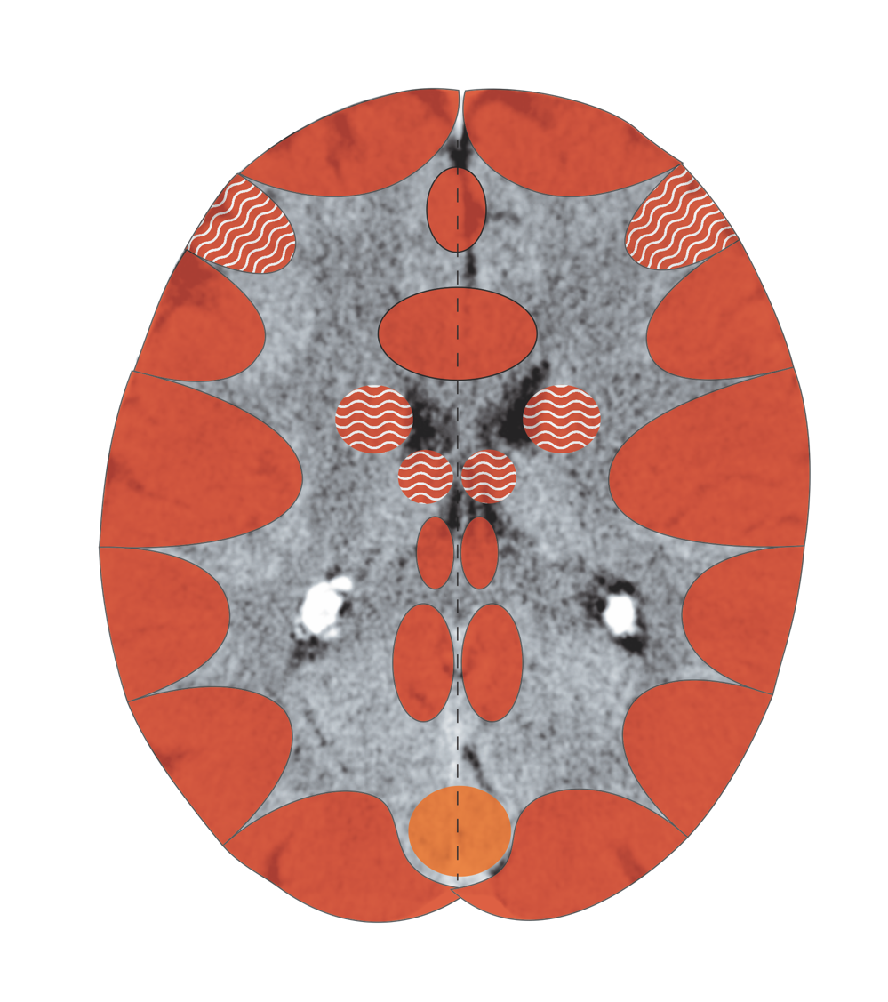
Cerebral Cortex – Superficial Bladder Mucosa
Notes:
4

Slide 5
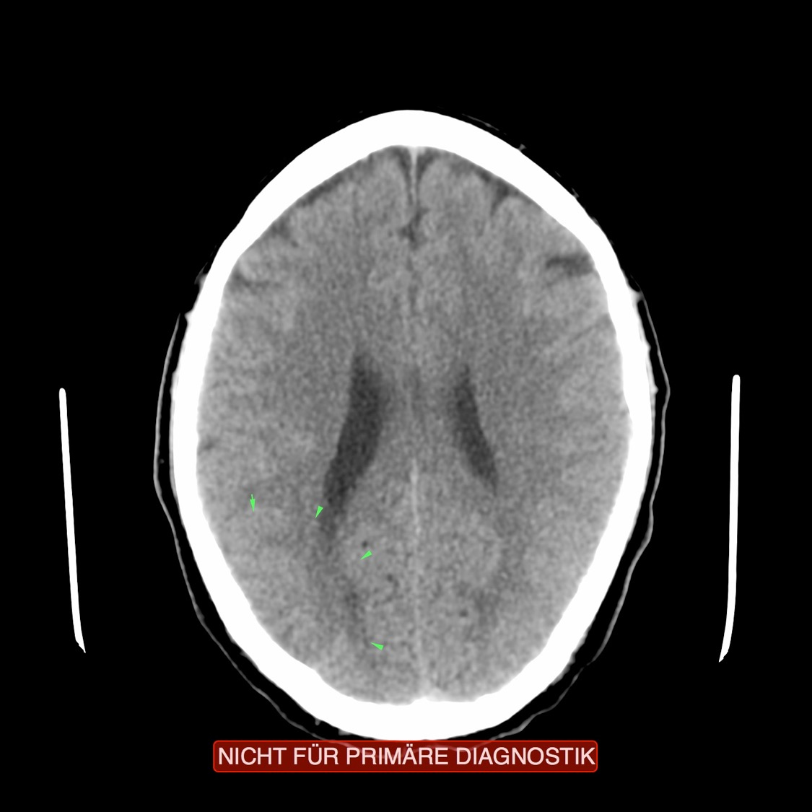
CT: Superficial Bladder Mucosa, Active Conflict

Slide 6
Bladder

Slide 7
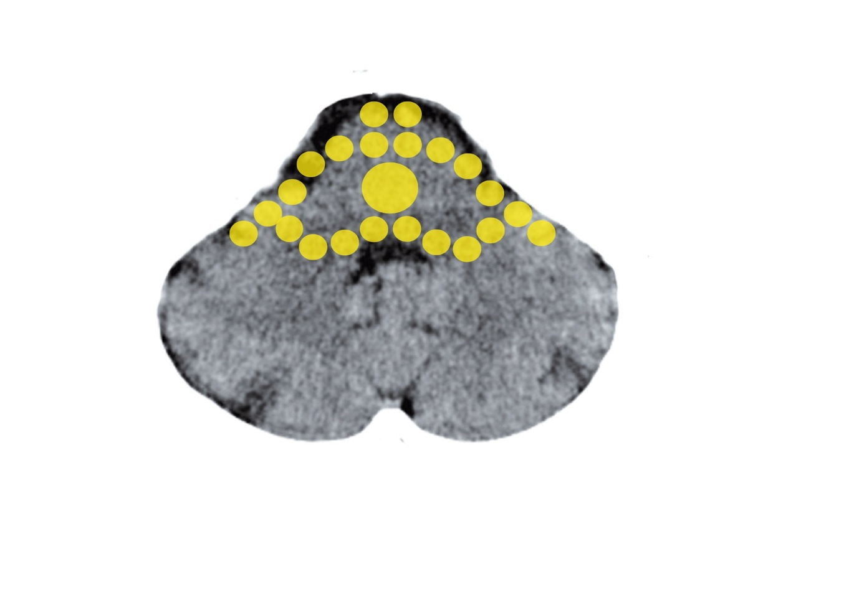
Brain Stem – Deep-lying Bladder Mucosa - Trigone
Mittelohr und Tuba eustachii - Stammhirn

Slide 8
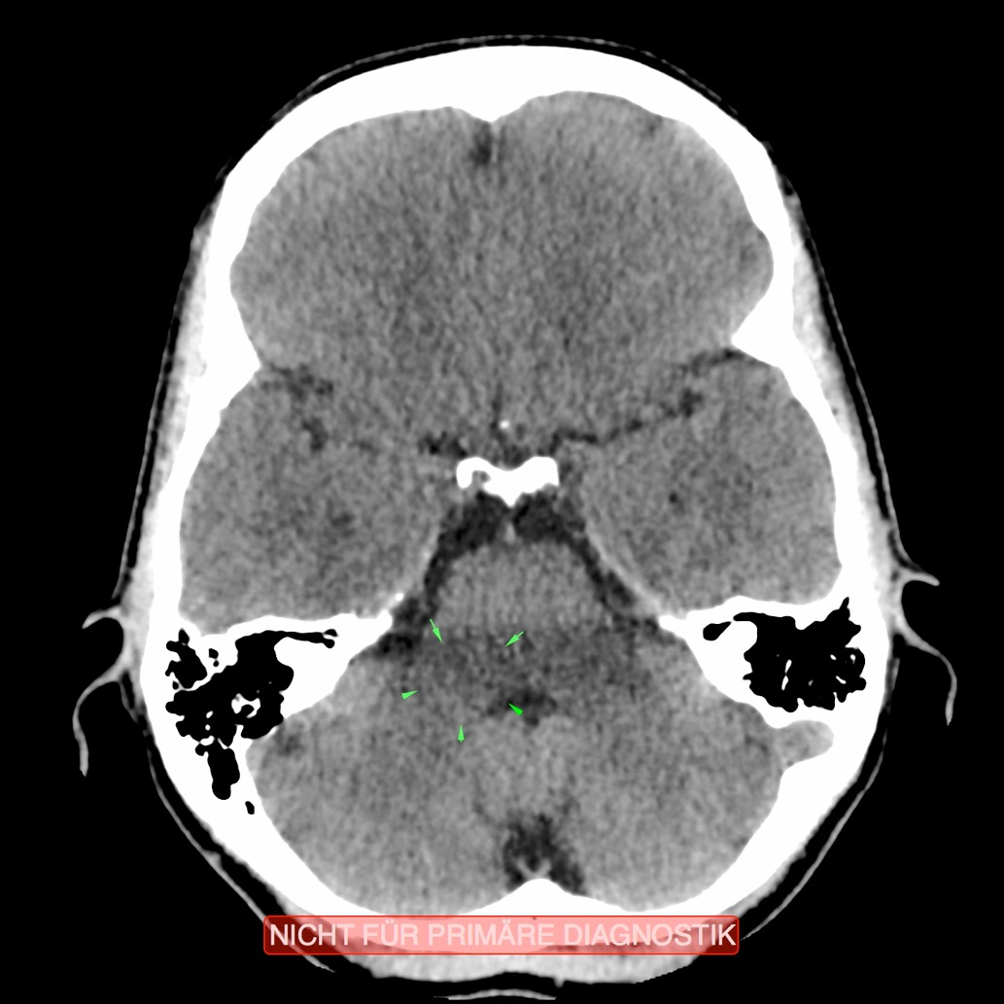
CT: Deep-lying Bladder Mucosa
Recurring Conflict

Slide 9
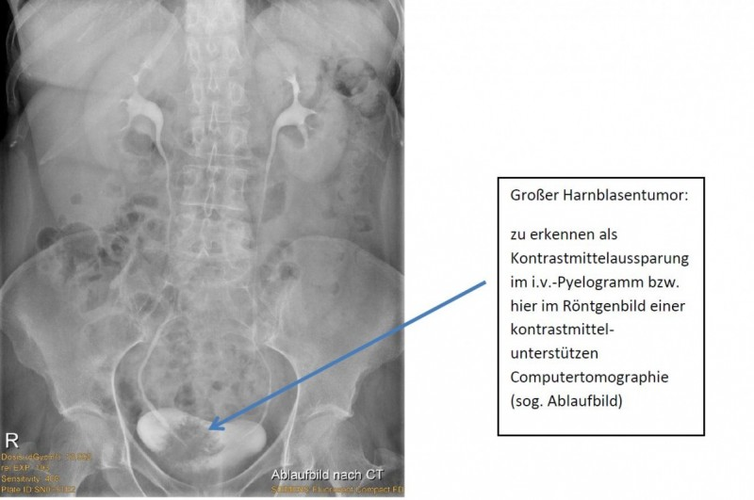
Large Tumor in the Bladder:
Recognizable in the contrast agent recess in an i.v. Pyelogram or here in the x-ray of a radiocontrast aided CT (so-called footprint)

Slide 10
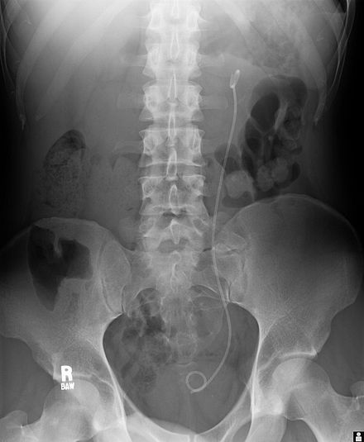
Catheter
from the
Renal Pelvis
into the
Bladder

Slide 11
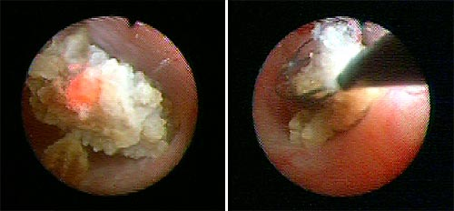
Destruction of a Stone with an Endoscope/Laser

Slide 12
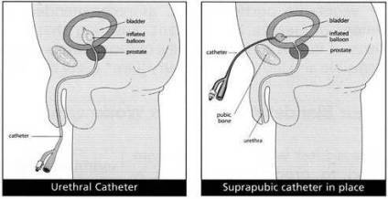
Urethral Catheter/Suprapubic Catheter

Slide 13
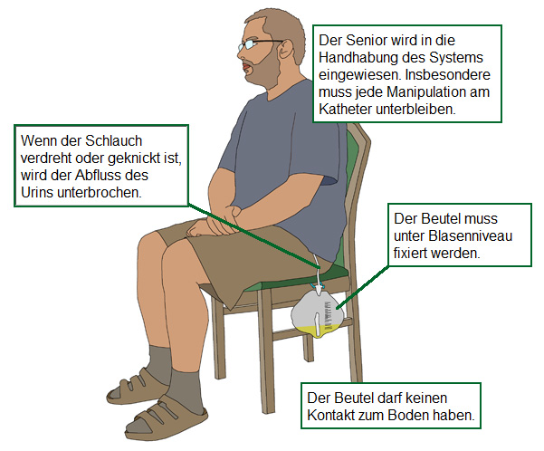
The patient will be trained in using the system. Manipulating the catheter must be prevented.
If the tube is twisted or kinked, the outflow of urine will be disrupted.
The bag must be fixed below bladder level.
The bag may not come in contact with the floor

Slide 14
