Slide 1
Kidneys

Slide 2
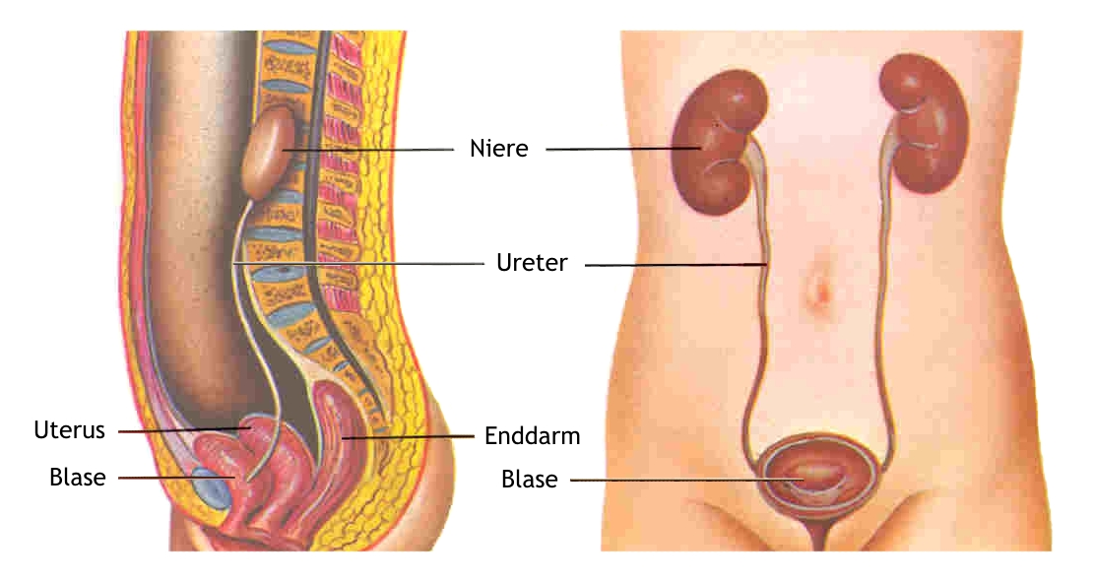
Kidneys - Overview

Slide 3
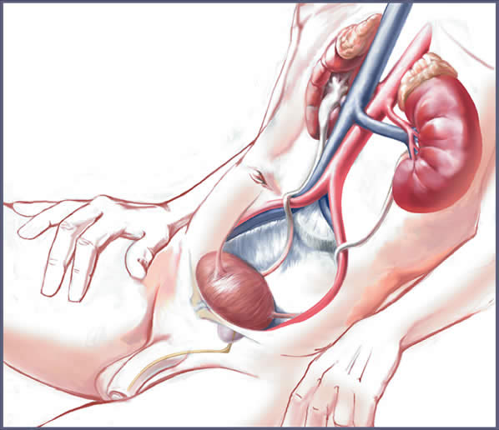
Ureters, Bladder

Slide 4
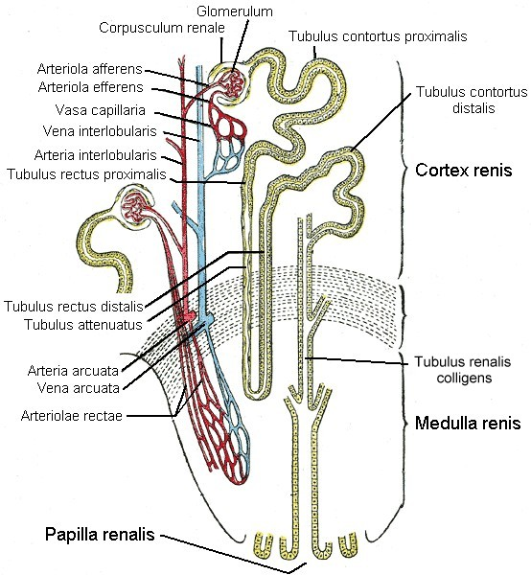

Slide 5
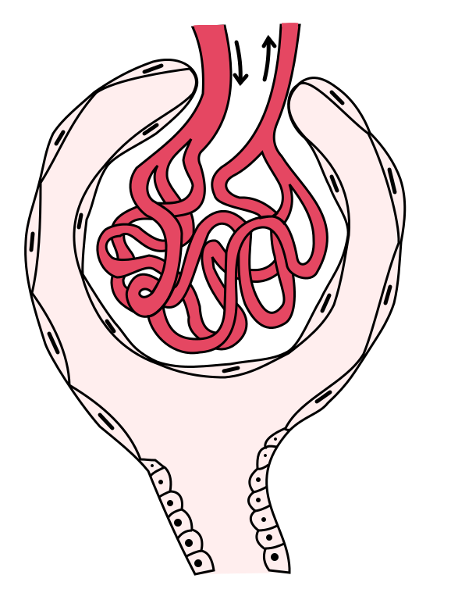
Capillary Column
(Glomerulus)
= Basic Tissue

Slide 6
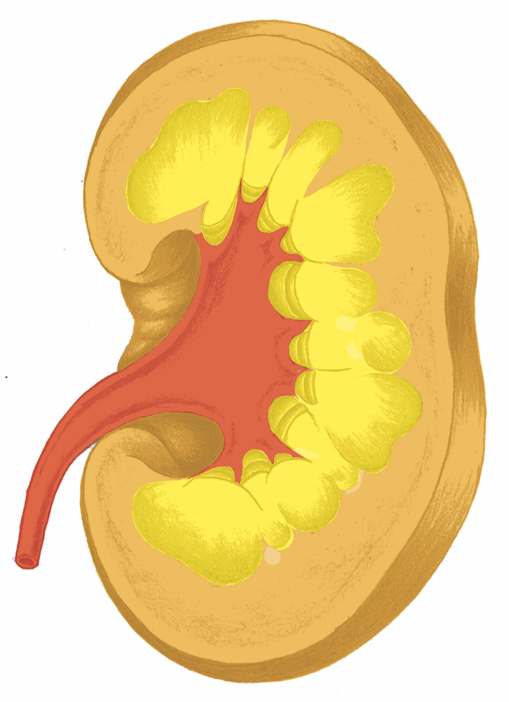
Kidney, Ureter

Slide 7
Ureter
Bladder
Urethra

Slide 8
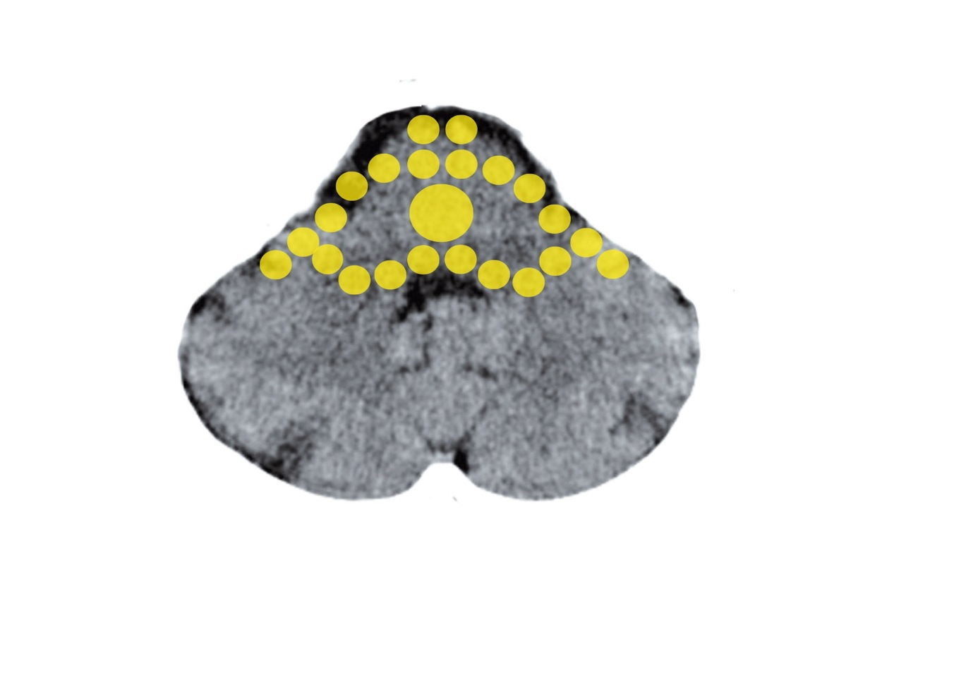
Brain Stem – Kidney Collection Tubules
Mittelohr und Tuba eustachii - Stammhirn

Slide 9
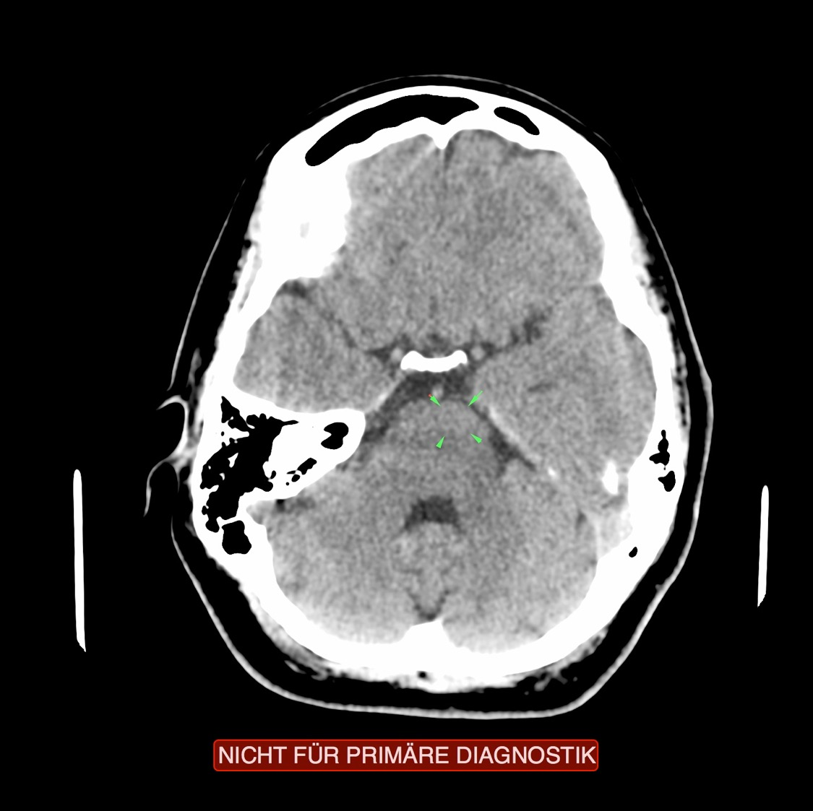
CT: Kidney Collection Tubules, Active Conflict

Slide 10
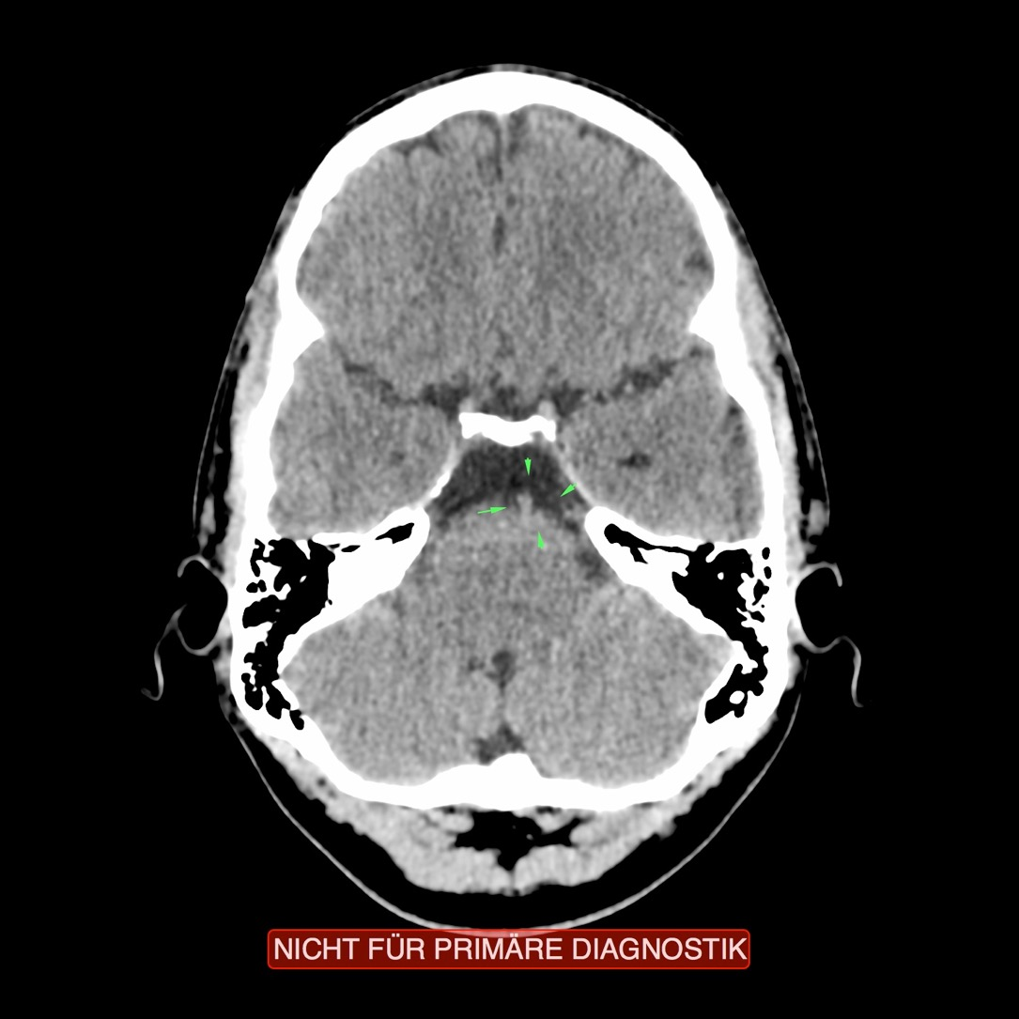
CT: Kidney Collection Tubules, Active Conflict

Slide 11
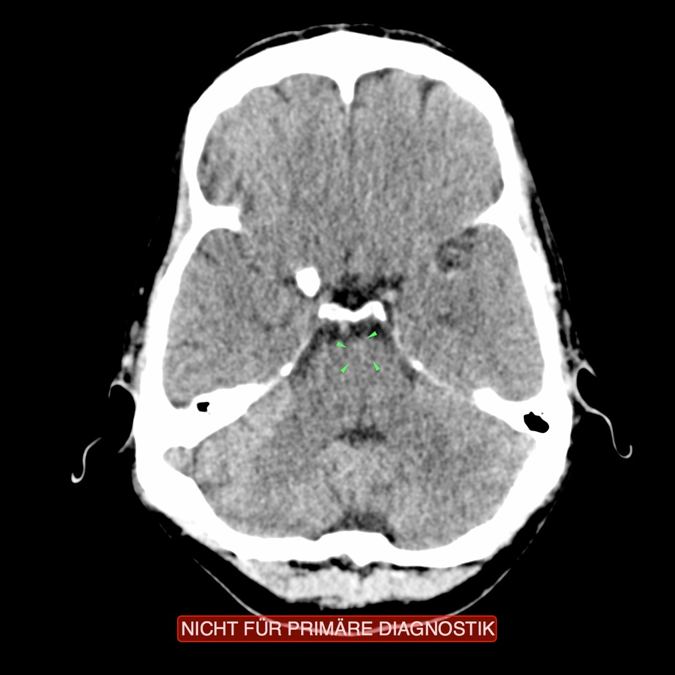
CT: Kidney Collection Tubules, Active Conflict

Slide 12
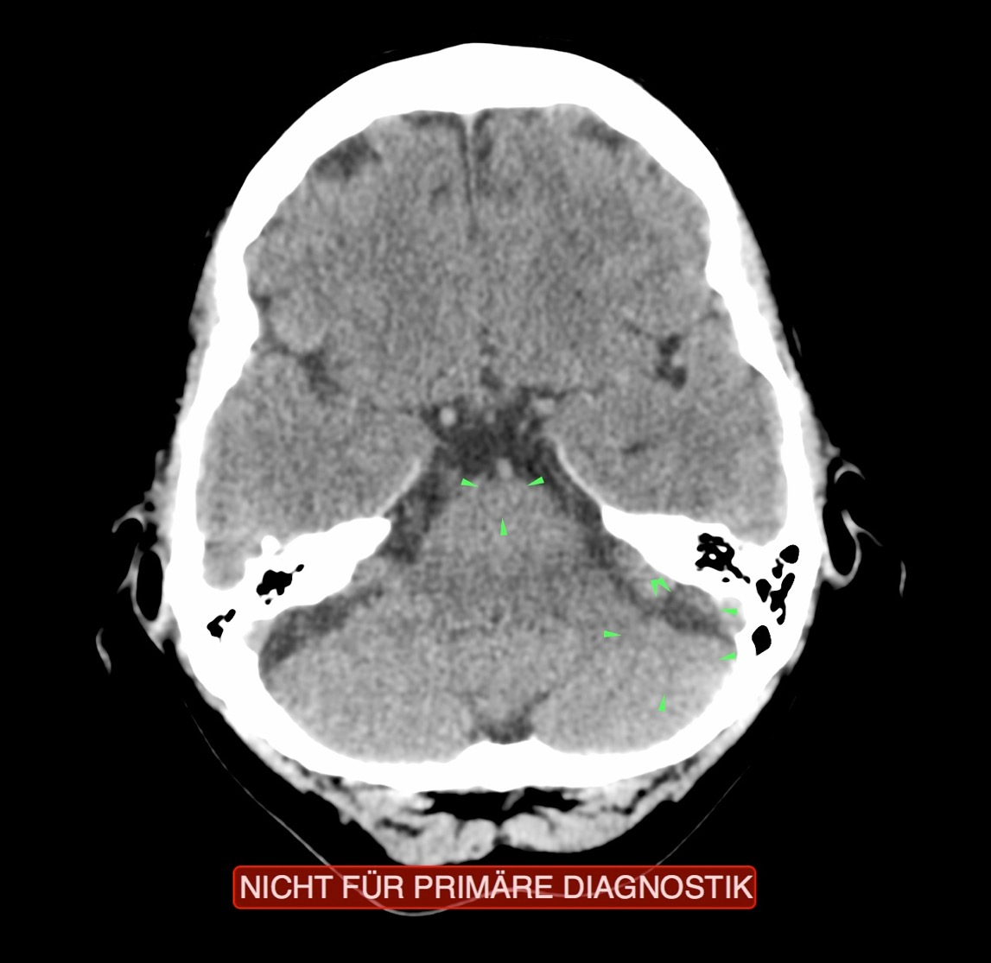
CT: Collection Tubules Active,
Mammary Glands Slightly Active

Slide 13
Active Kidney Collection Tubules: Outward Strabismus

Slide 14
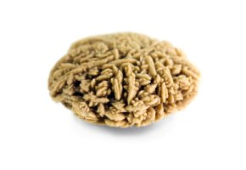
Kidney Stone – Collection Tubules

Slide 15
Polycystic Kidney Weighing over 1 kg

Slide 16
Around Grieskirchen
With an average body mass index (BMI = ratio between body weight and height) of 25.9, Upper Austrian city dwellers are Austria’s most overweight inhabitants.

Slide 17
The demographic area with the highest unemployment will once again be the inner city. It will come in much higher than the expected state average of 4.9%.

Slide 18
Kidney, Ureter

Slide 19
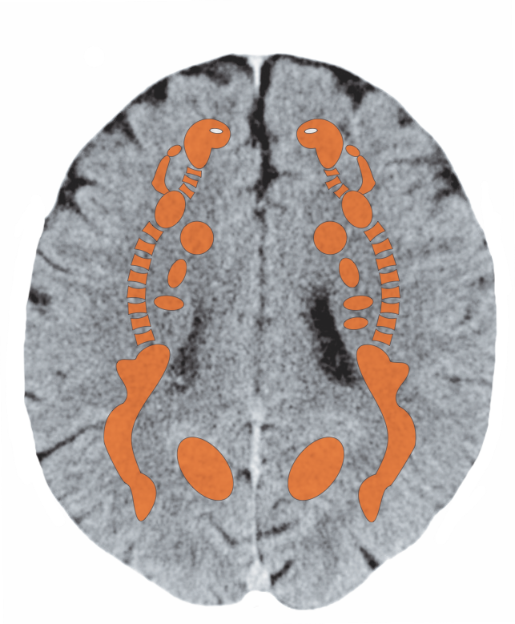
Cerebral White Matter

Slide 20
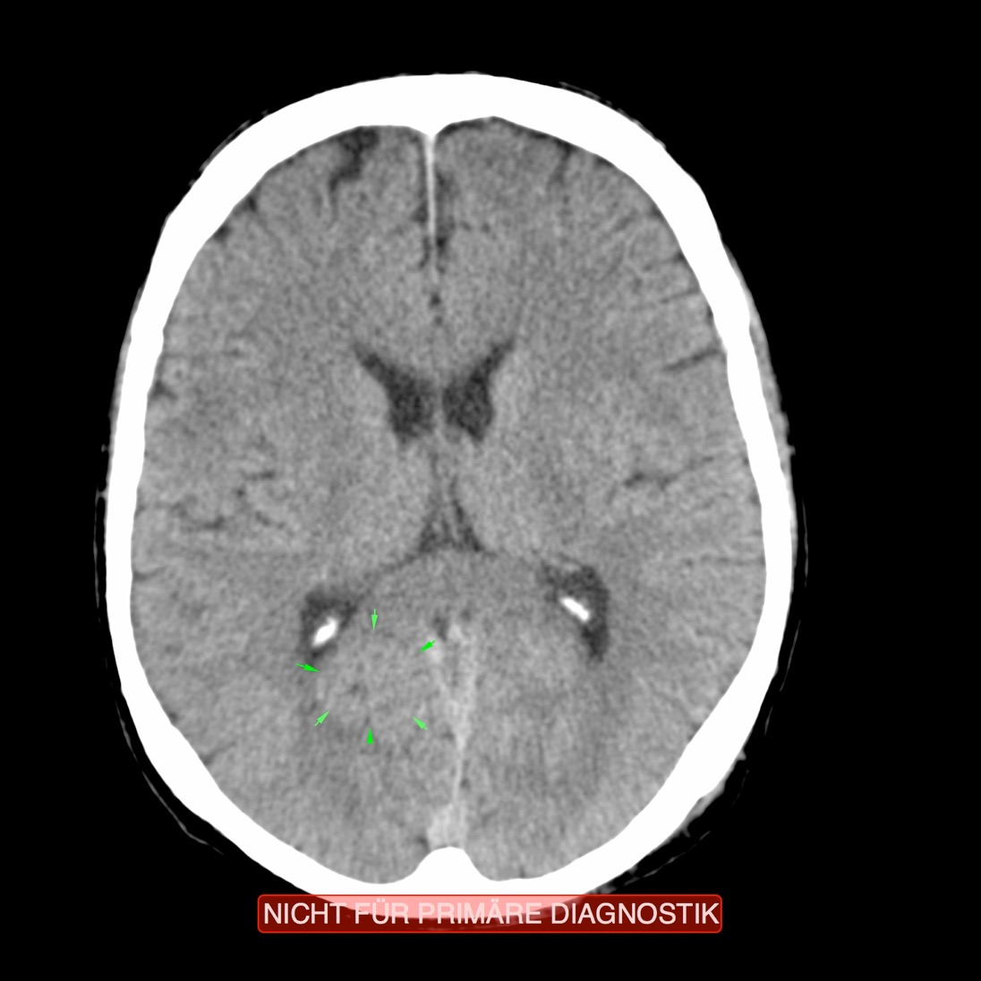
CT: Kidney Parenchyma, Active Conflict

Slide 21
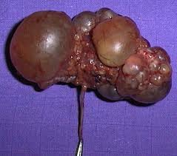
Kidney
Cysts

Slide 22
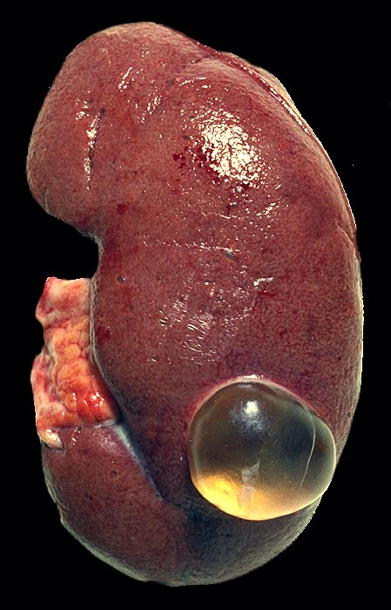
Kidney cyst diagnosis:
Solitary, smooth walled
kidney cyst filled with
serous fluid, found
during autopsy.
Rarely in children,
often in adults,
especially in kidneys
with glomerulosclerosis
Mostly asymptomatic.
= Parenchyma

Slide 23
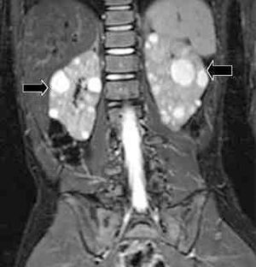
Kidney
Cysts on
Both Sides

Slide 24
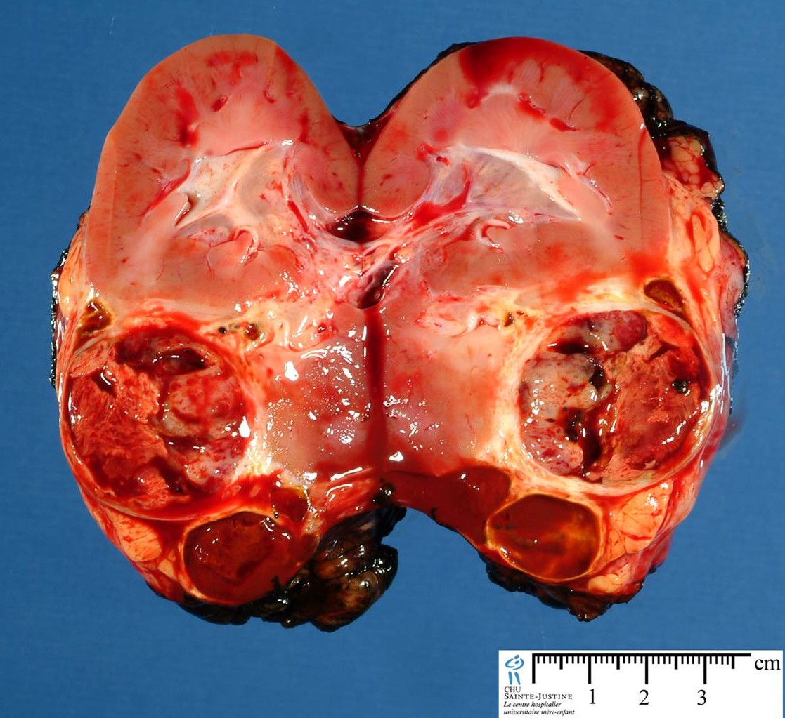
Wilms’
Tumor
after
Removal

Slide 25
Kidney, Ureter

Slide 26
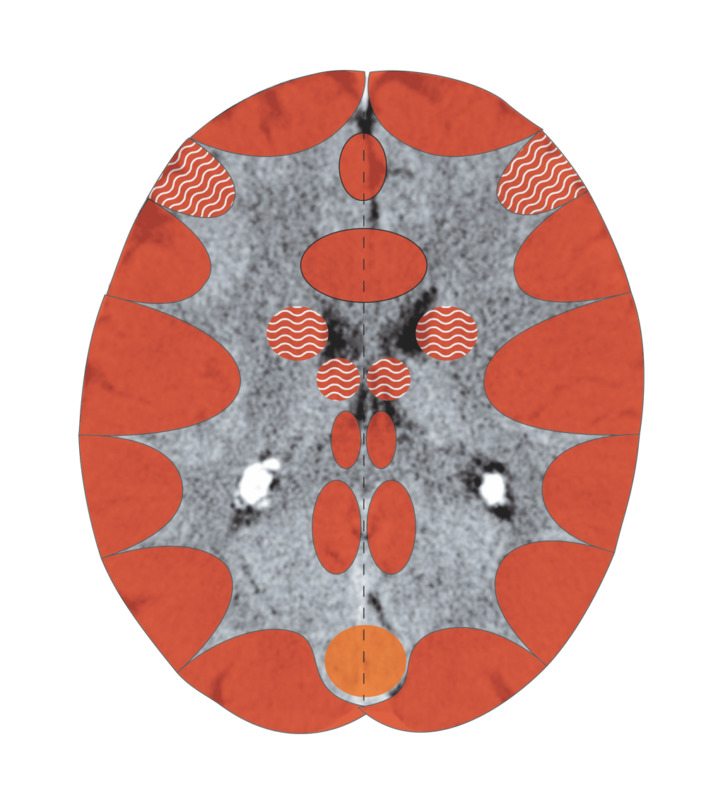
Cerebral Cortex – Renal Pelvis, Ureter, Bladder
Notes:
26

Slide 27
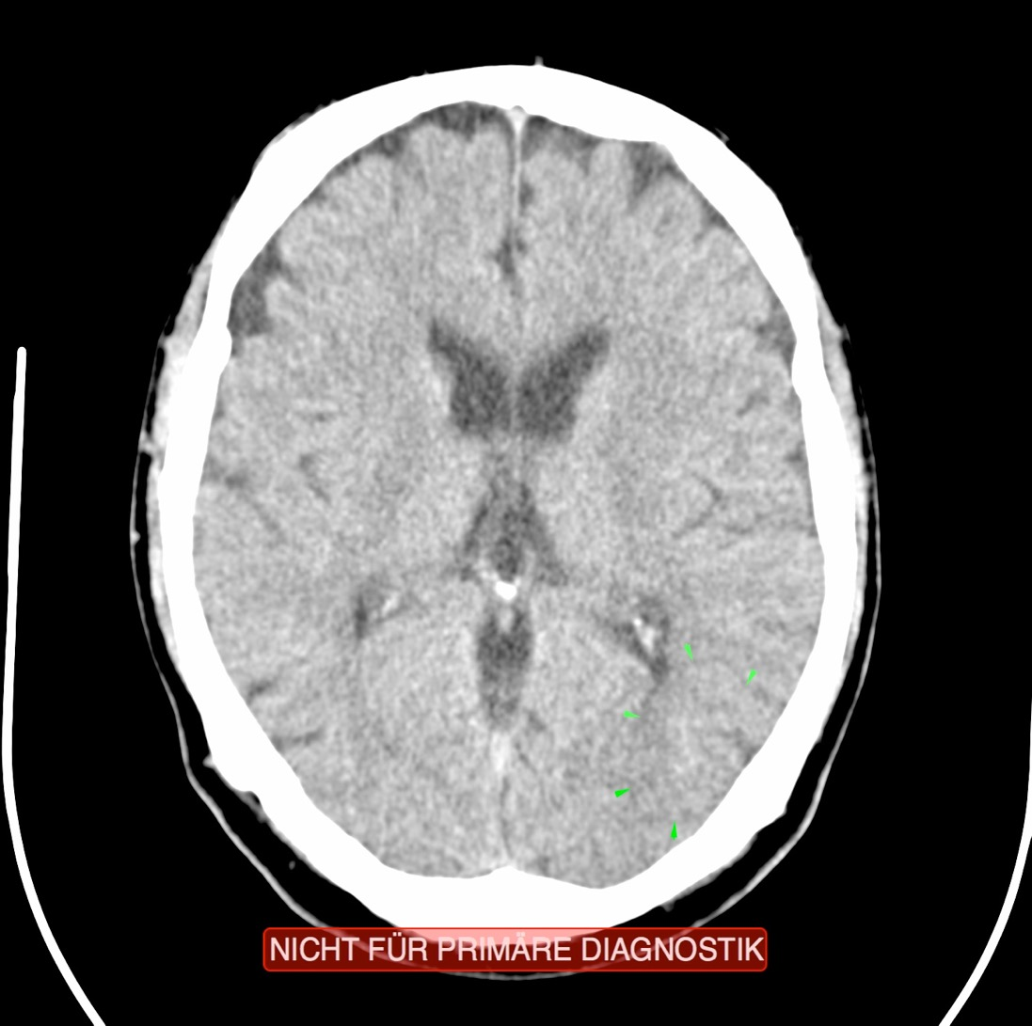
CT: Renal Pelvis, Recurring Conflict

