Slide 1
Teeth
Jaw

Slide 2
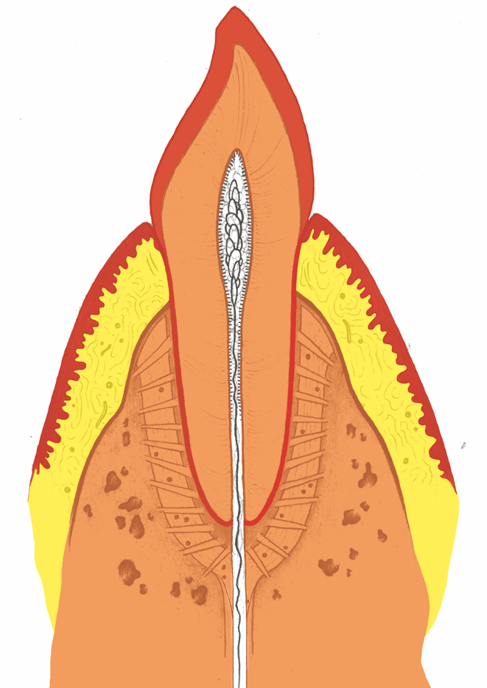
Teeth

Slide 3
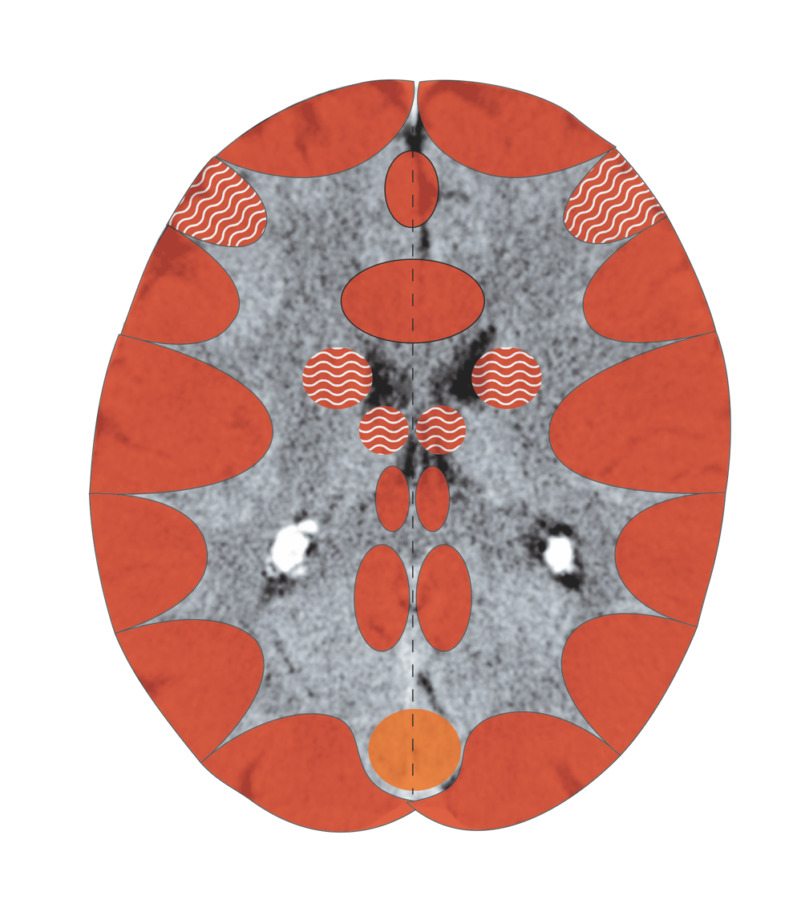
Cerebral Cortex – Tooth Enamel
Notes:
3

Slide 4
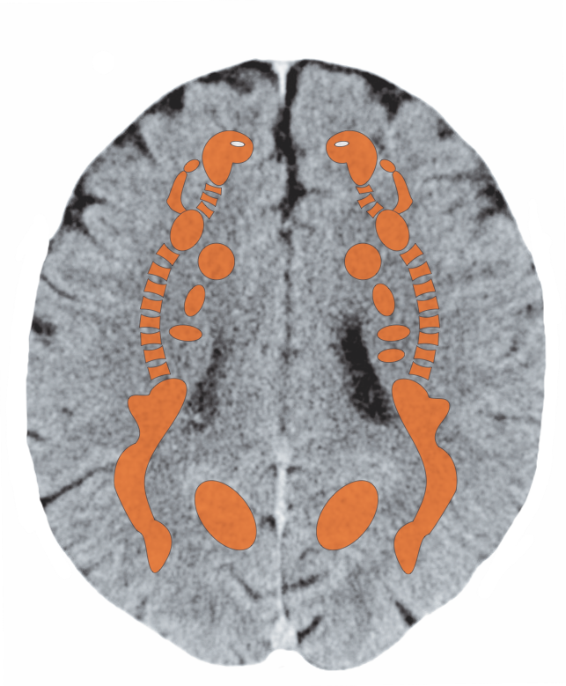
Cerebral White Matter – Dentin

Slide 5
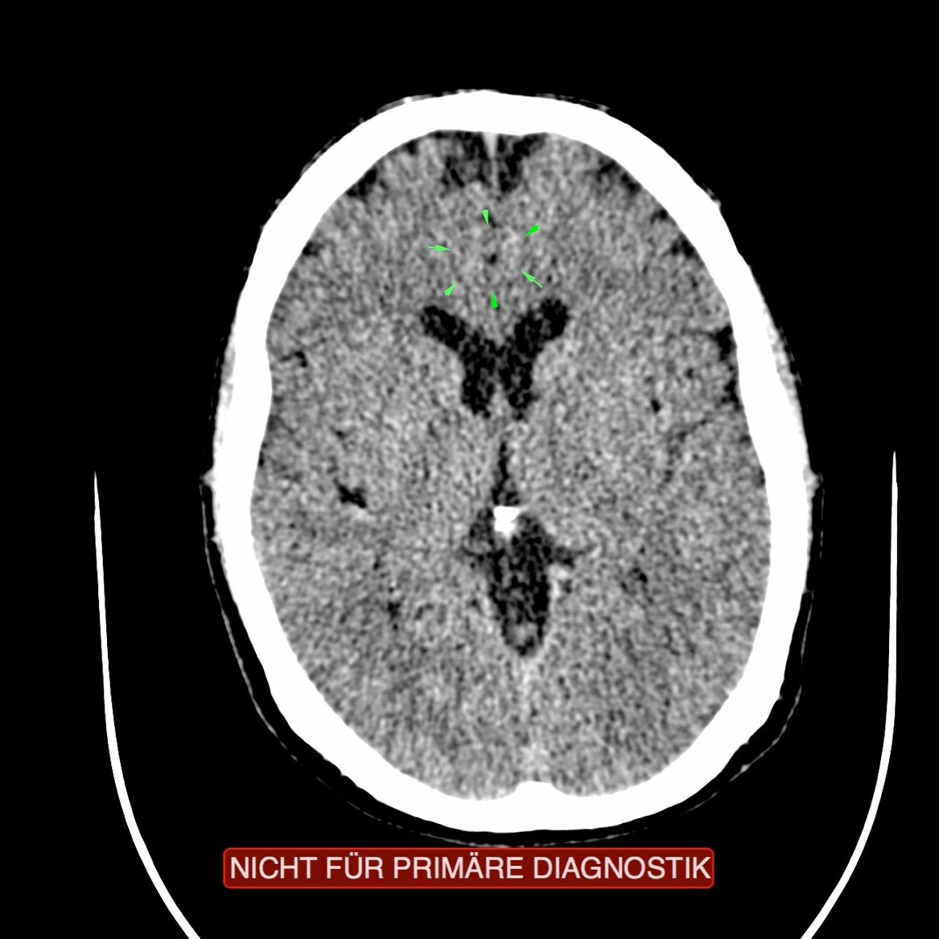
CCT: Tooth Enamel and Dentin,
Recurring Conflict

Slide 6
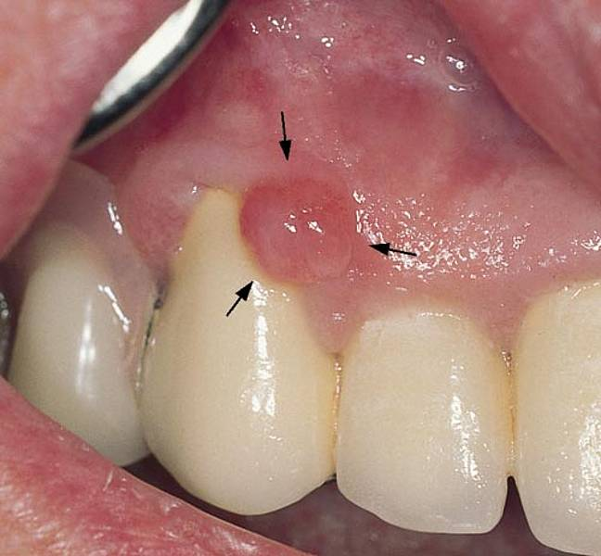
Proliferation of the Periodontium - Epulis

Slide 7
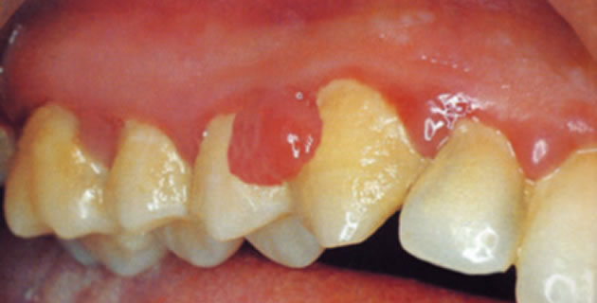
Proliferation of the Gums (Gingiva) - Epulis

Slide 8
Root Canal Treatment – Dentin

Slide 9
Dead Tooth – Dentin

