Slide 1
Pulmonary
Pleurae

Slide 2
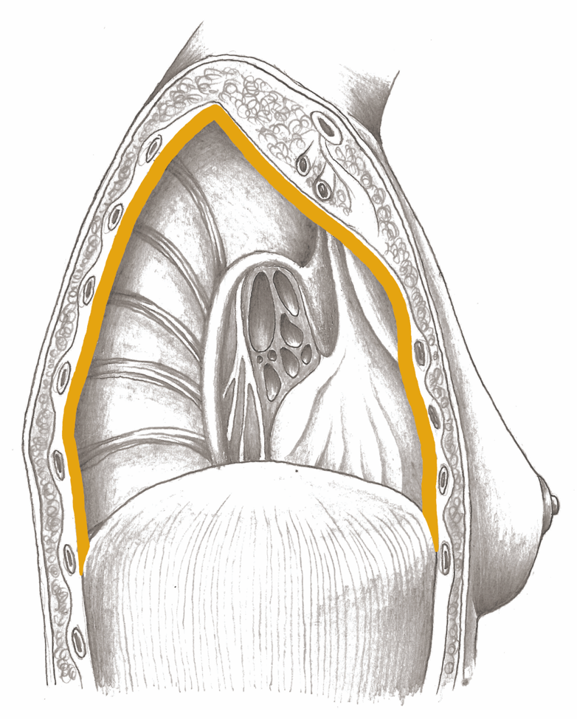
Pulmonary Pleurae

Slide 3
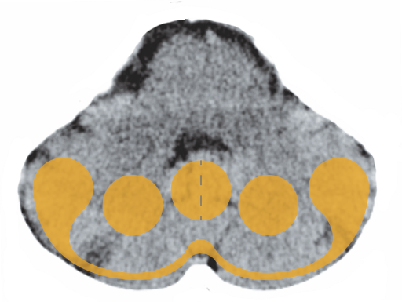
Cerebellum – Pulmonary Pleurae

Slide 4
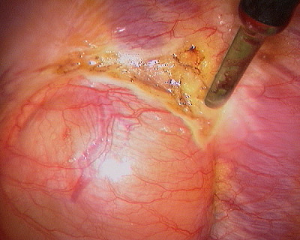
Tumor on the Pleura

Slide 5
Pleural Effusion – Repair Phase

