Slide 1
Larynx

Slide 2
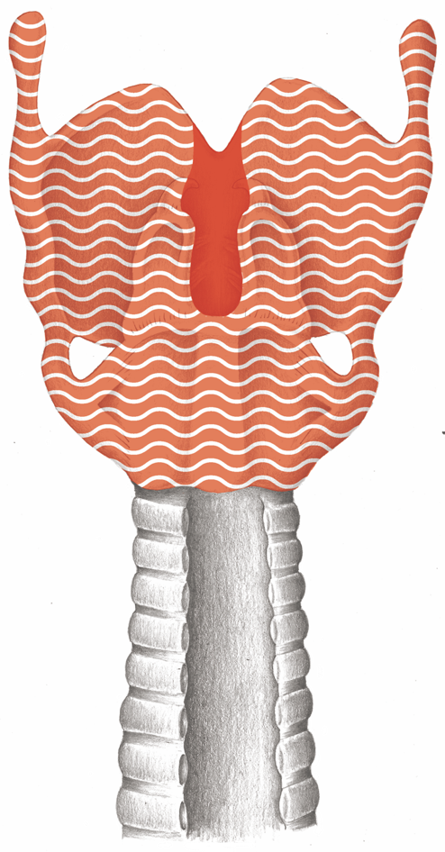
Larynx

Slide 3
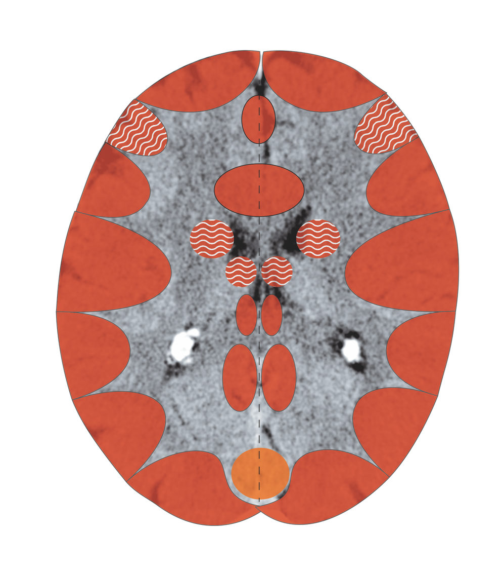
Cerebral Cortex – Laryngeal musculature, mucosa
Notes:
3

Slide 4
Larynx – Wernicke’s and Broca’s Areas

Slide 5
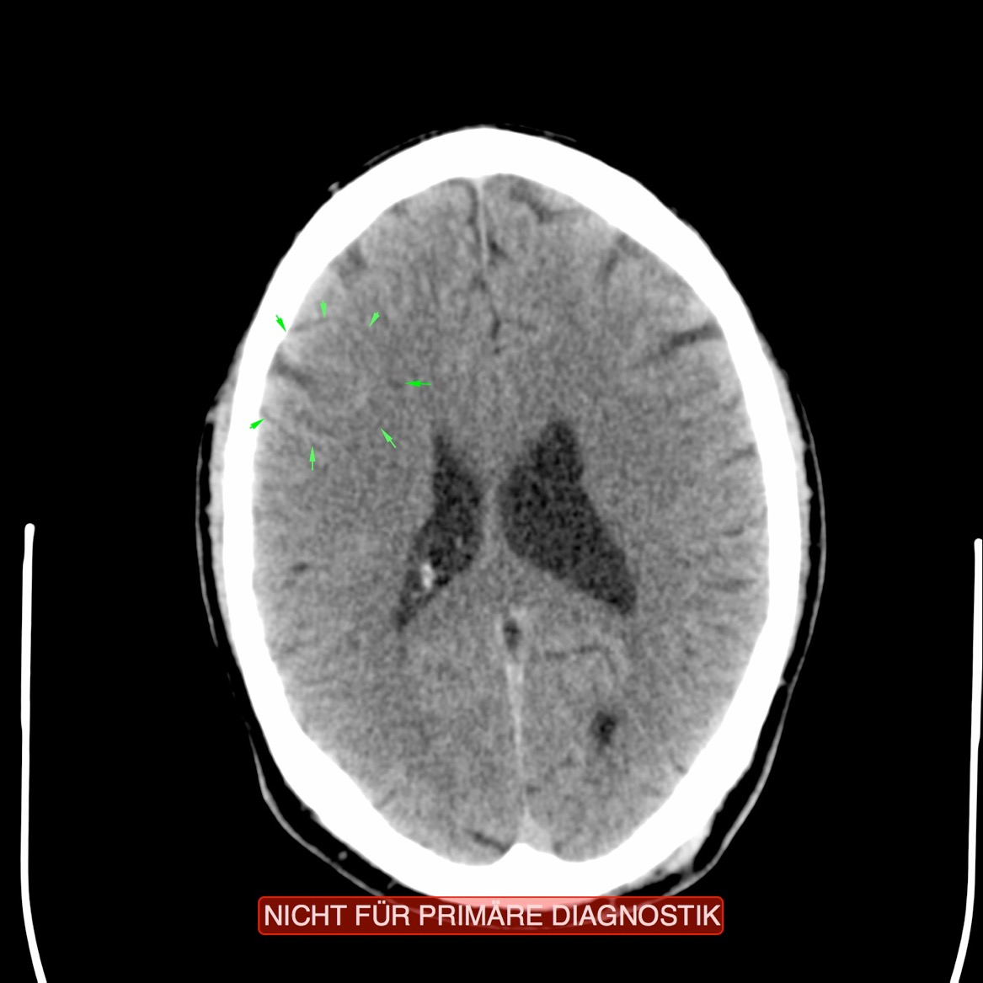
CT: Laryngeal Mucosa Active

Slide 6
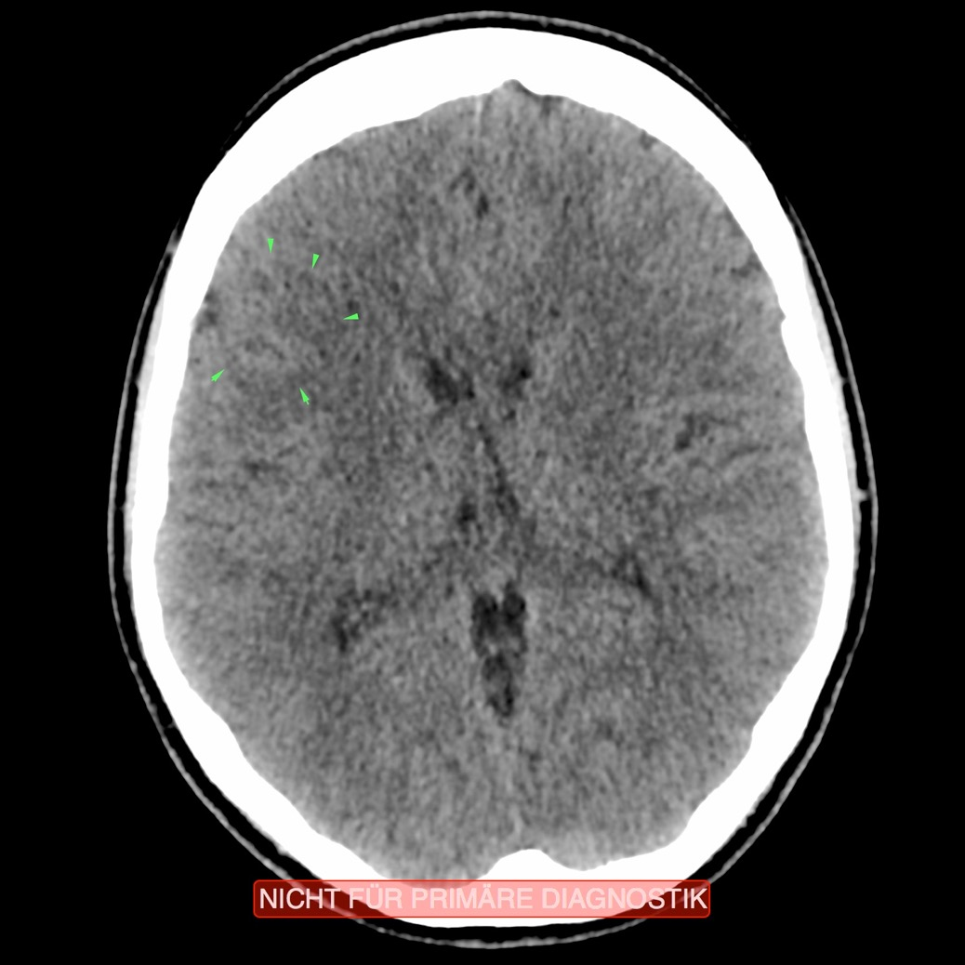
CT: Laryngeal Mucosa Recurring

Slide 7
Pneumokokken
Orthodox Medicine: “Infection” with Pneumococci

