Slide 1
Heart

Slide 3
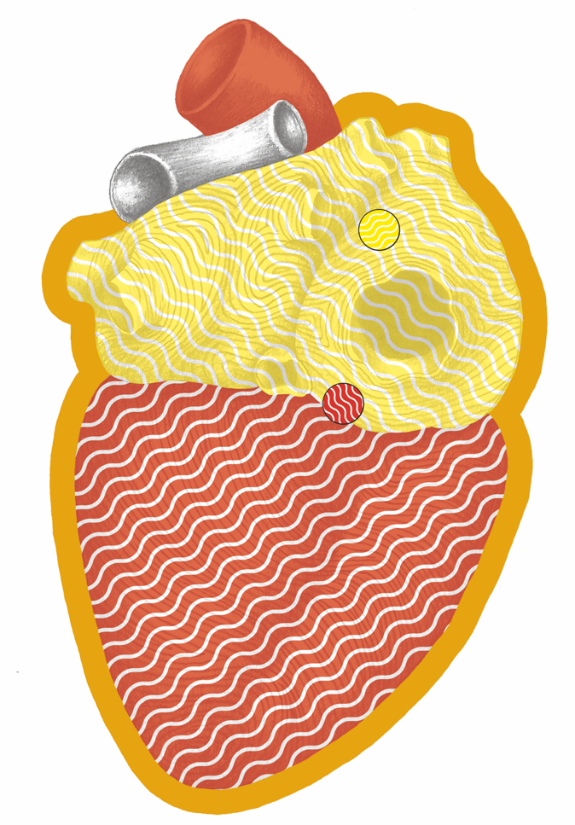
Heart Overview

Slide 4
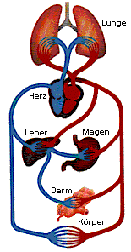
Circulation

Slide 5
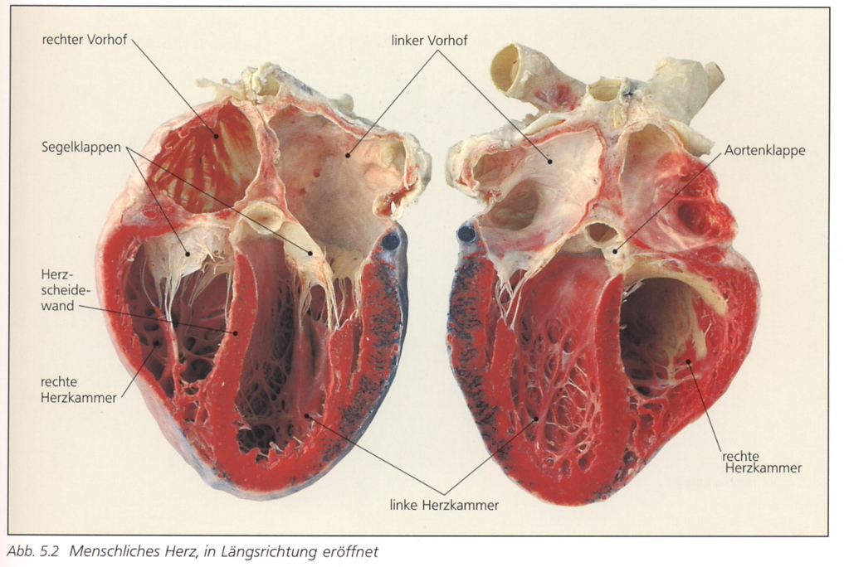
Heart Chambers - Cross-section

Slide 6
Cardiac Muscle

Slide 7
Heart Attack – Pain Areas

Slide 8
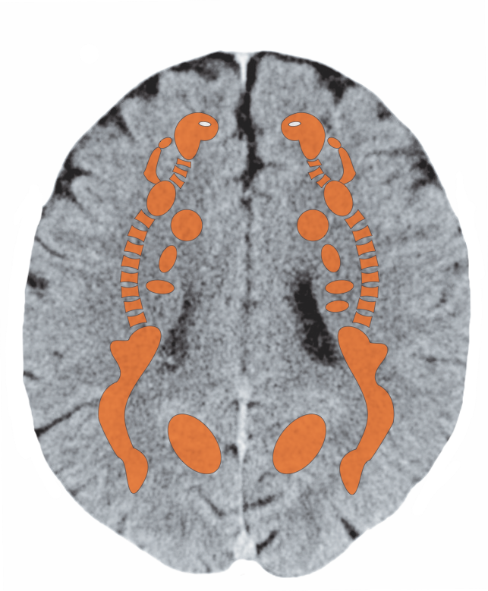
Cerebral White Matter –– Cardiac Muscle

Slide 9
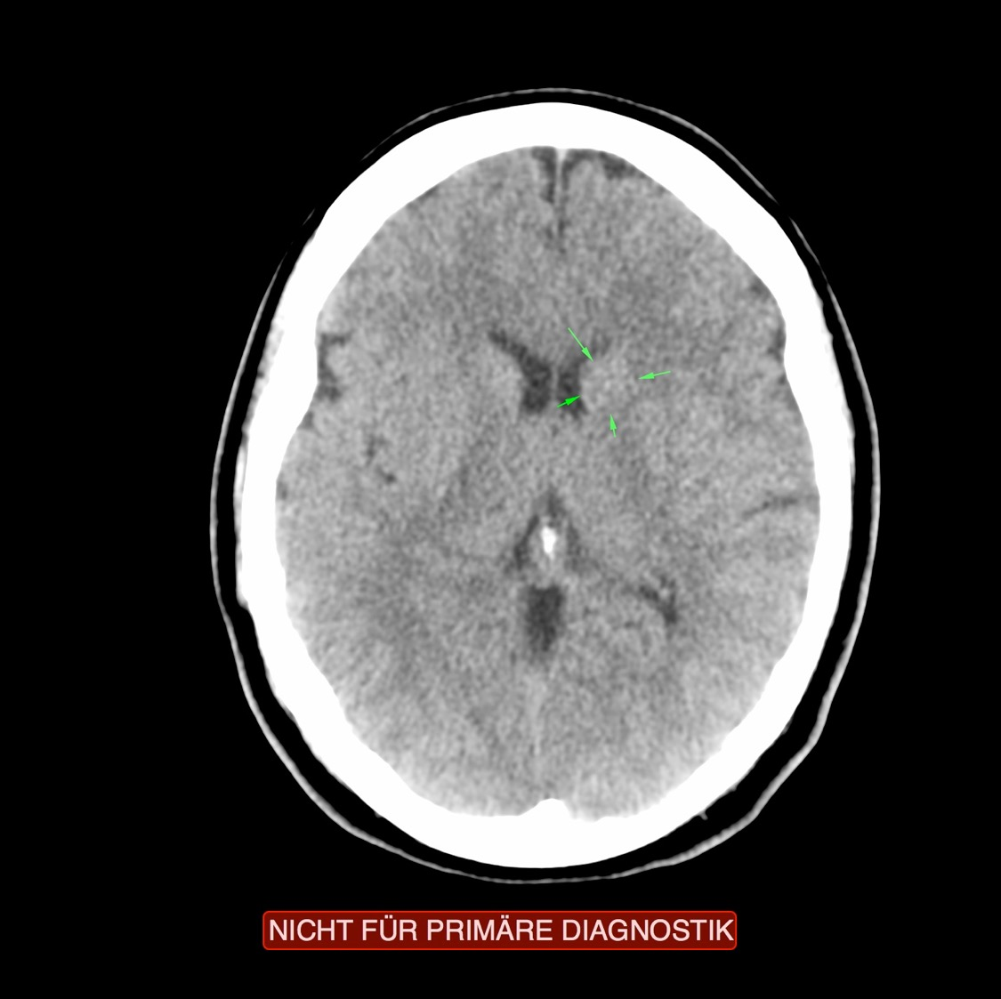
CT: Cardiac Muscle, Recurring Conflict

Slide 10
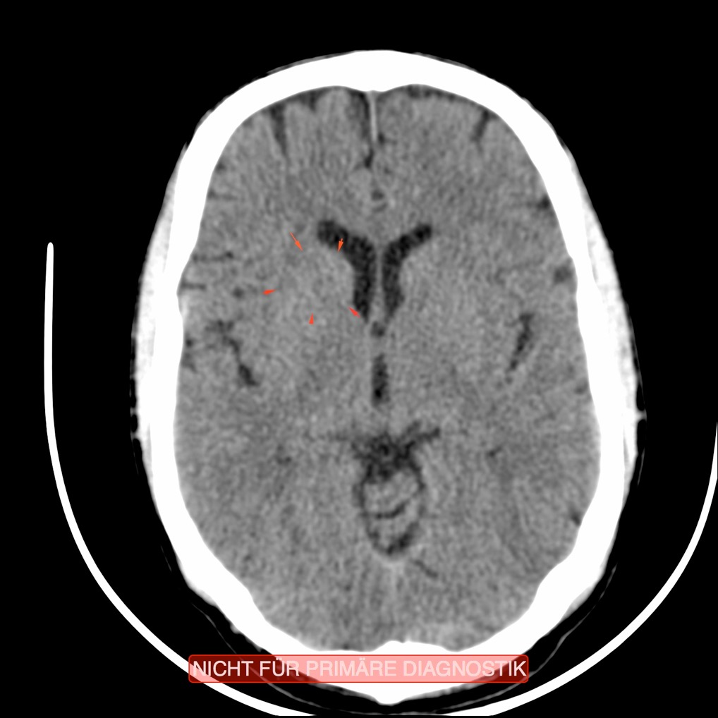
CT: Cardiac Muscle, Recurring Conflict

Slide 11
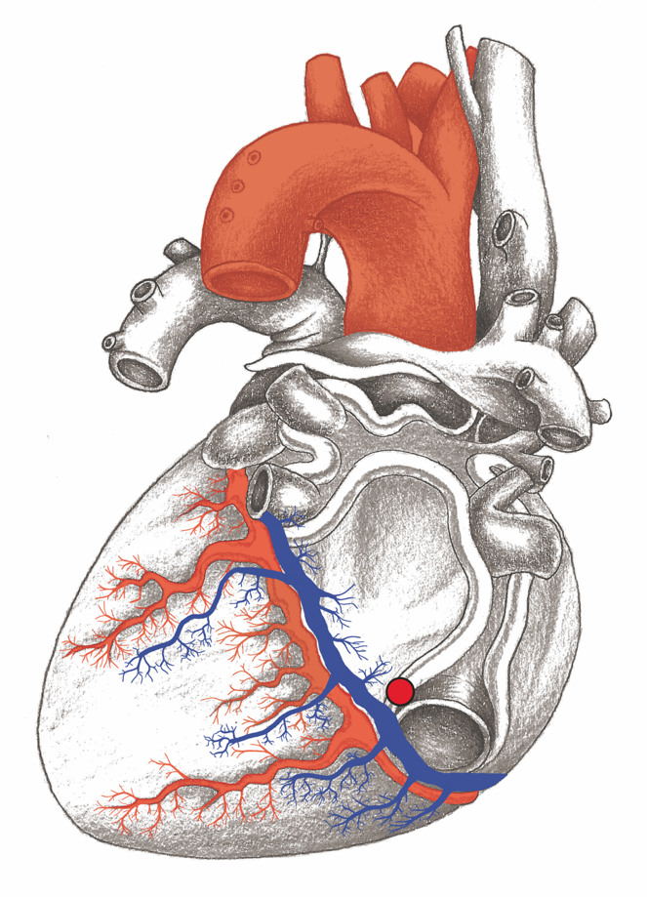
Coronary Arteries

Slide 12
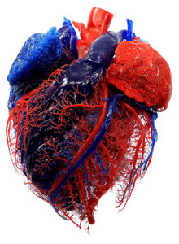
Coronary Arteries – Resin Cast

Slide 13
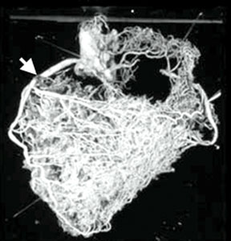
Coronary Arteries – Arterial Bypass

Slide 14
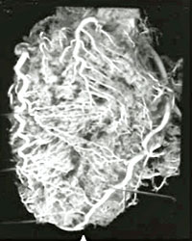
Coronary Arteries – Arterial Bypass

Slide 15
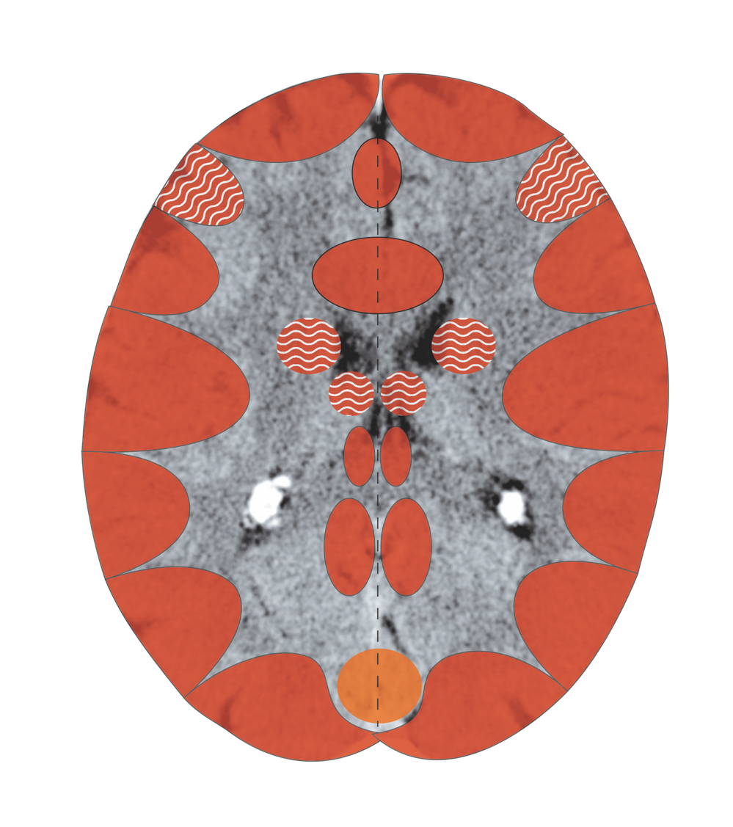
Coronary Arteries
Notes:
15

Slide 16
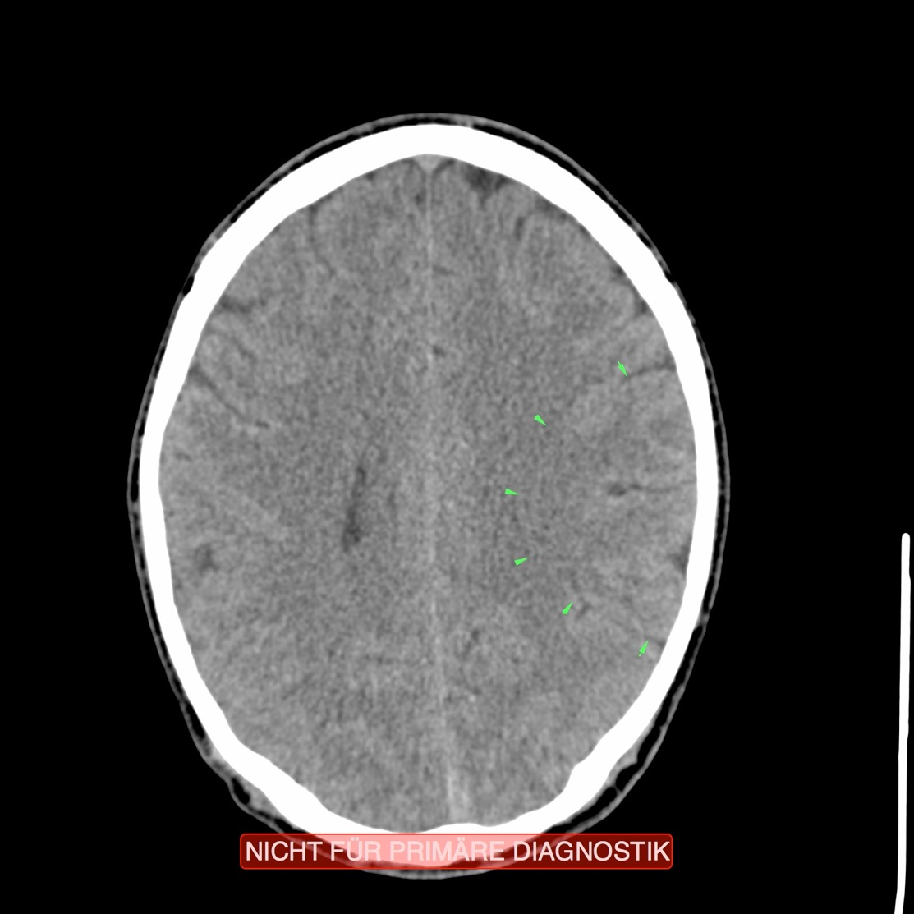
CT: Coronary Arteries (Territorial Loss), Active C.

Slide 17
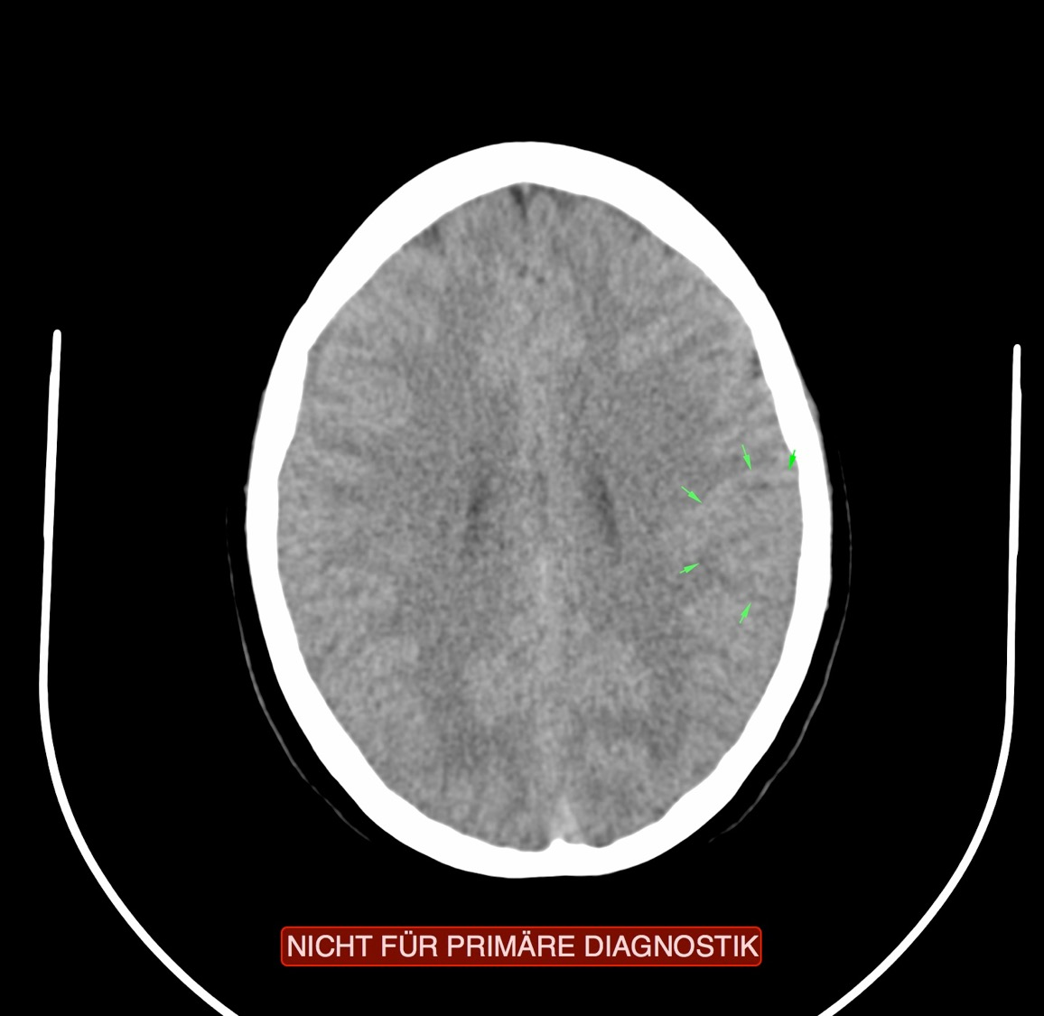
CT: Coronary Arteries (Territorial Loss), Active C.

Slide 18
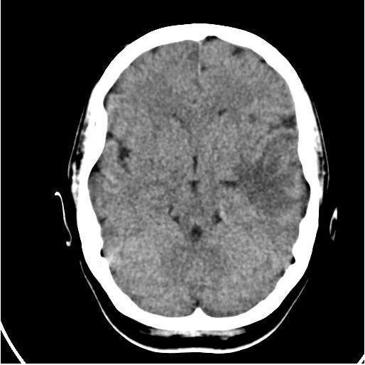
CT: Coronary Arteries in Repair (Territorial Loss)

Slide 19
Udo Jürgens – His Last Performance

Slide 20
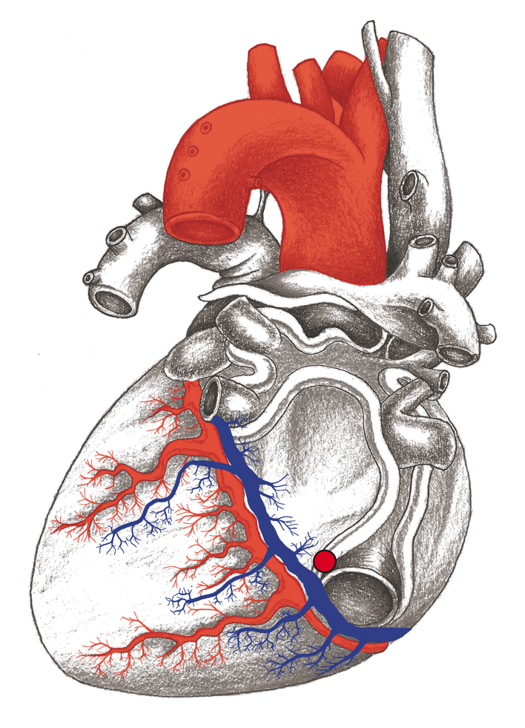
Coronary Arteries – Coronary Veins

Slide 21
Circulation

Slide 22
Coronary Veins
Notes:
22

Slide 23
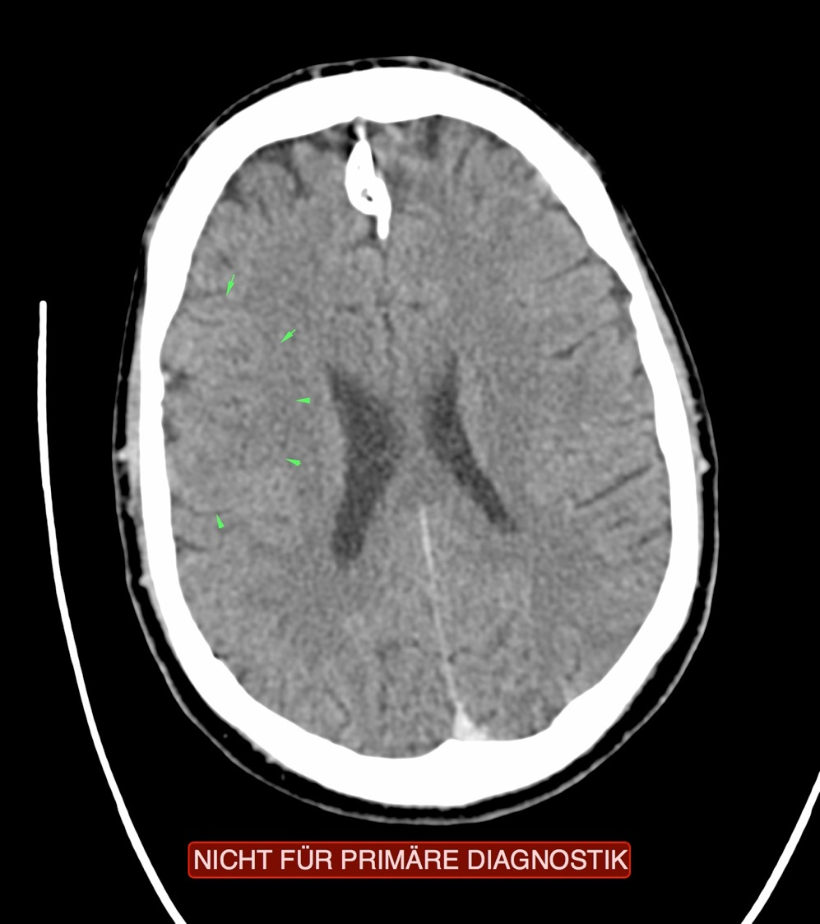
CT: Coronary Veins, Recurring Conflict

Slide 24
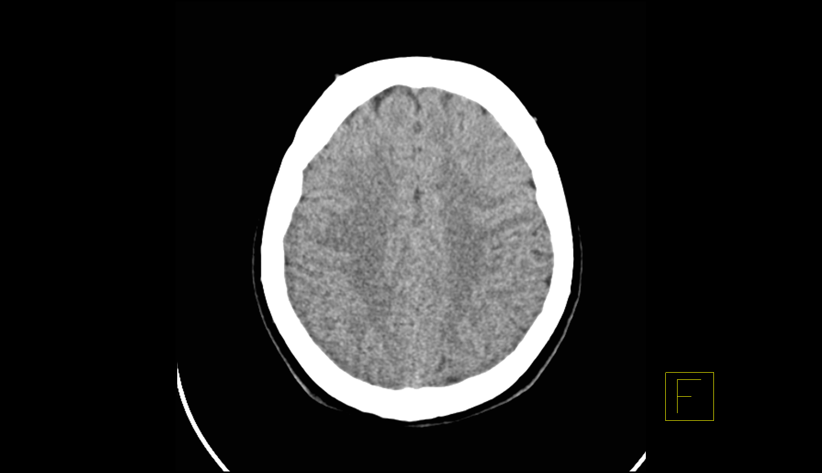
CT: Coronary Veins – Recurring Conflict

Slide 25
Pericardium

Slide 26
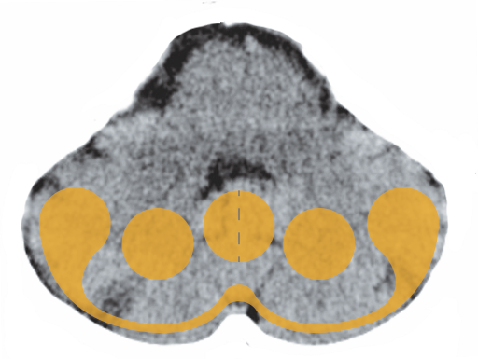
Pericardium in the Cerebellum

Slide 27
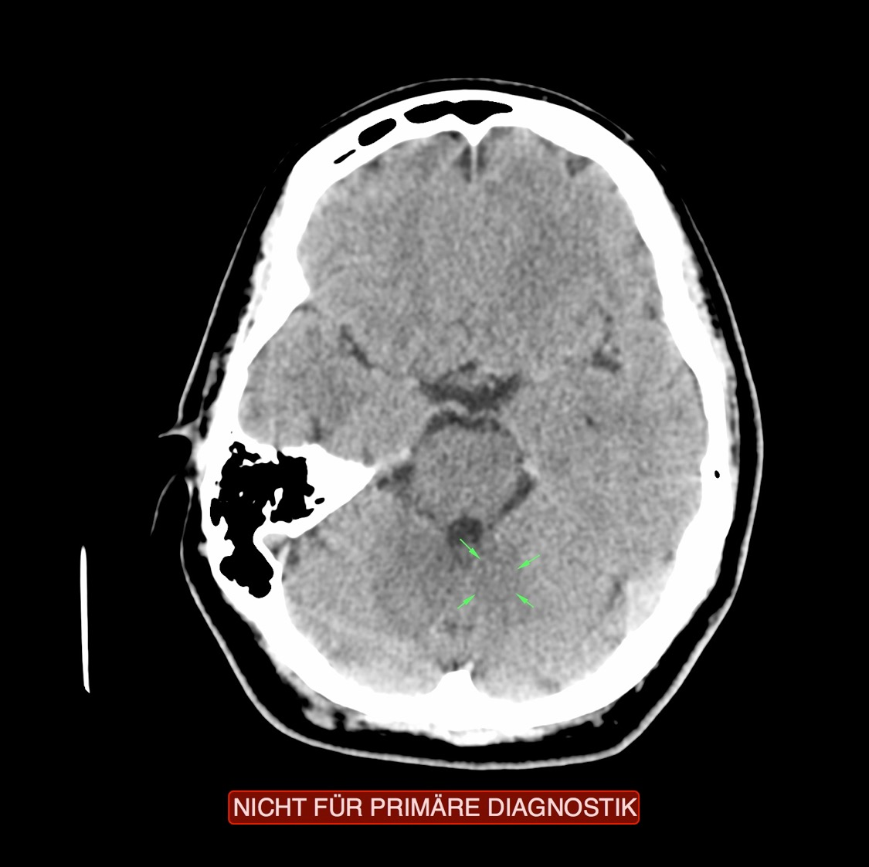
CT: Pericardium, Active Conflict

Slide 28
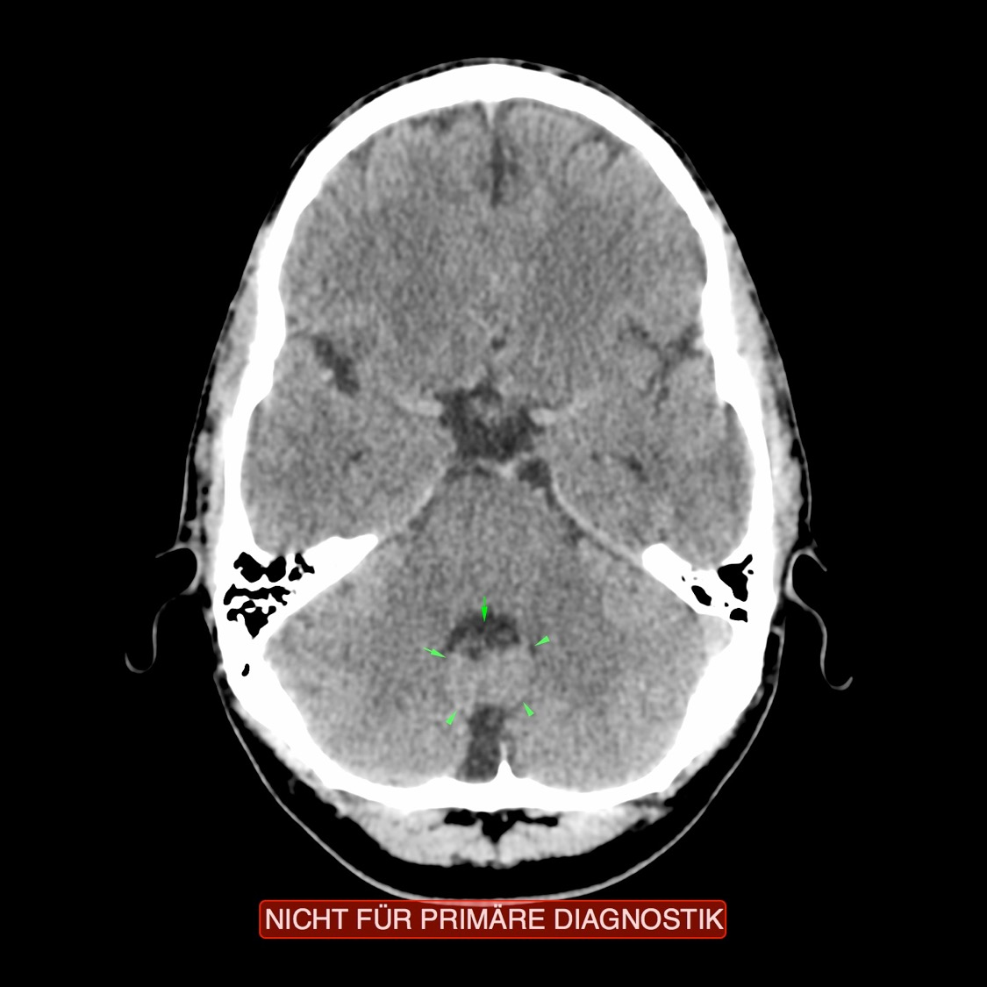
CT: Pericardium, Repair Phase

Slide 29
Pericardium – Overview

Slide 30
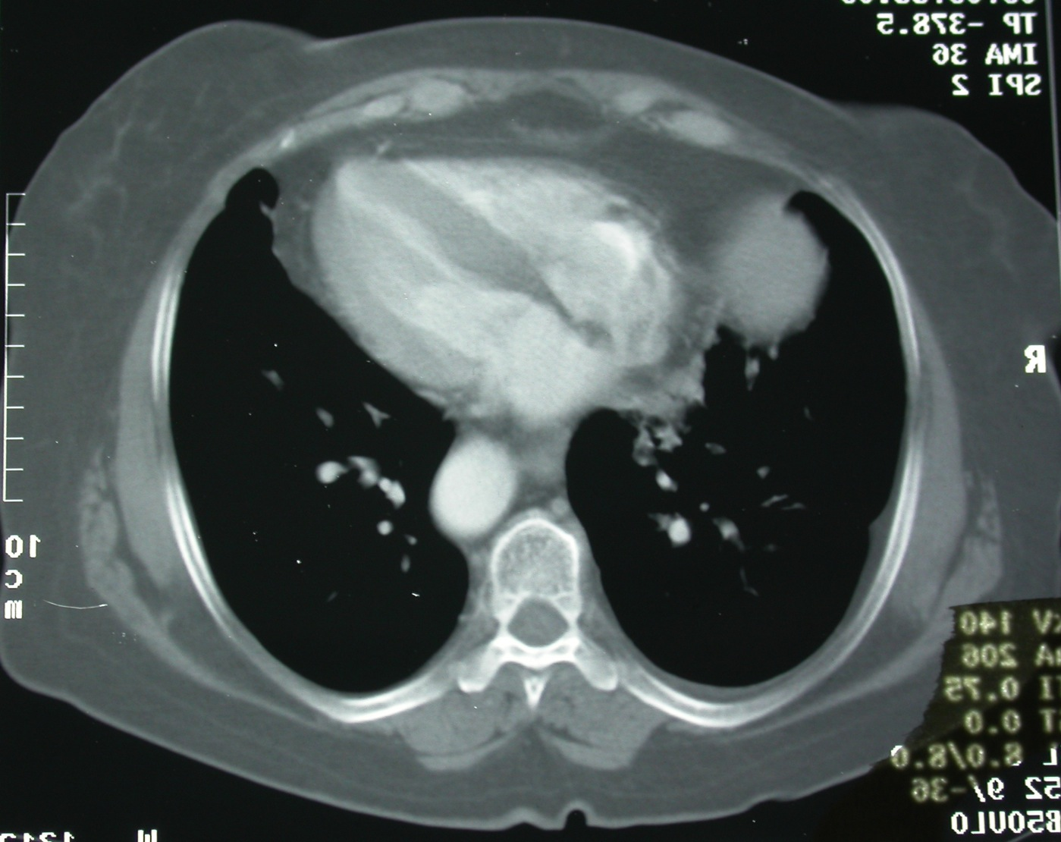
CT: Pericardial Effusion – Repair Phase

Slide 31
“Fused” Pericardium: Fibrinous Pericarditis

Slide 32
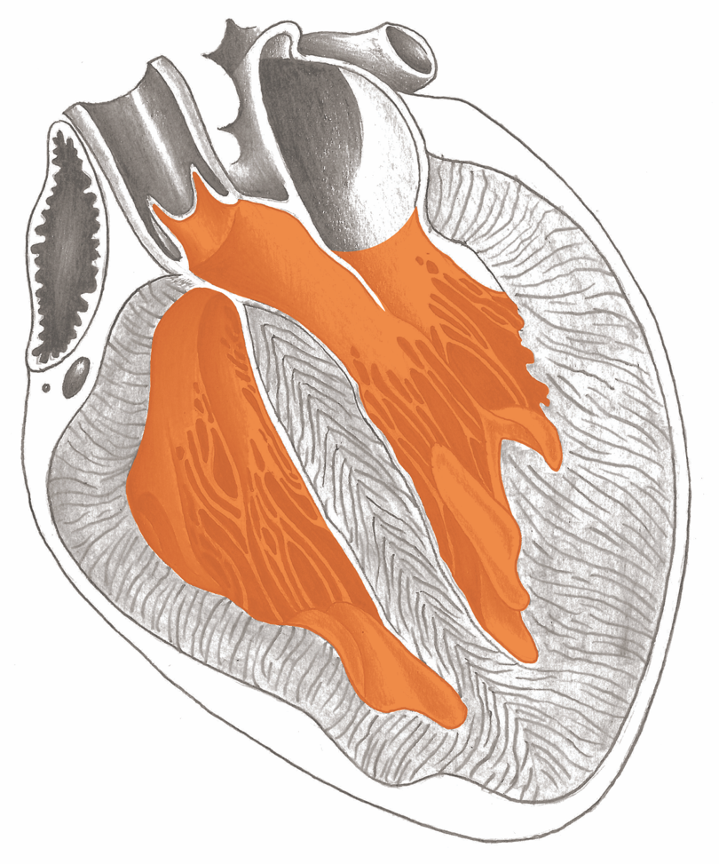
Heart Valves

