Slide 1
Ear

Slide 2
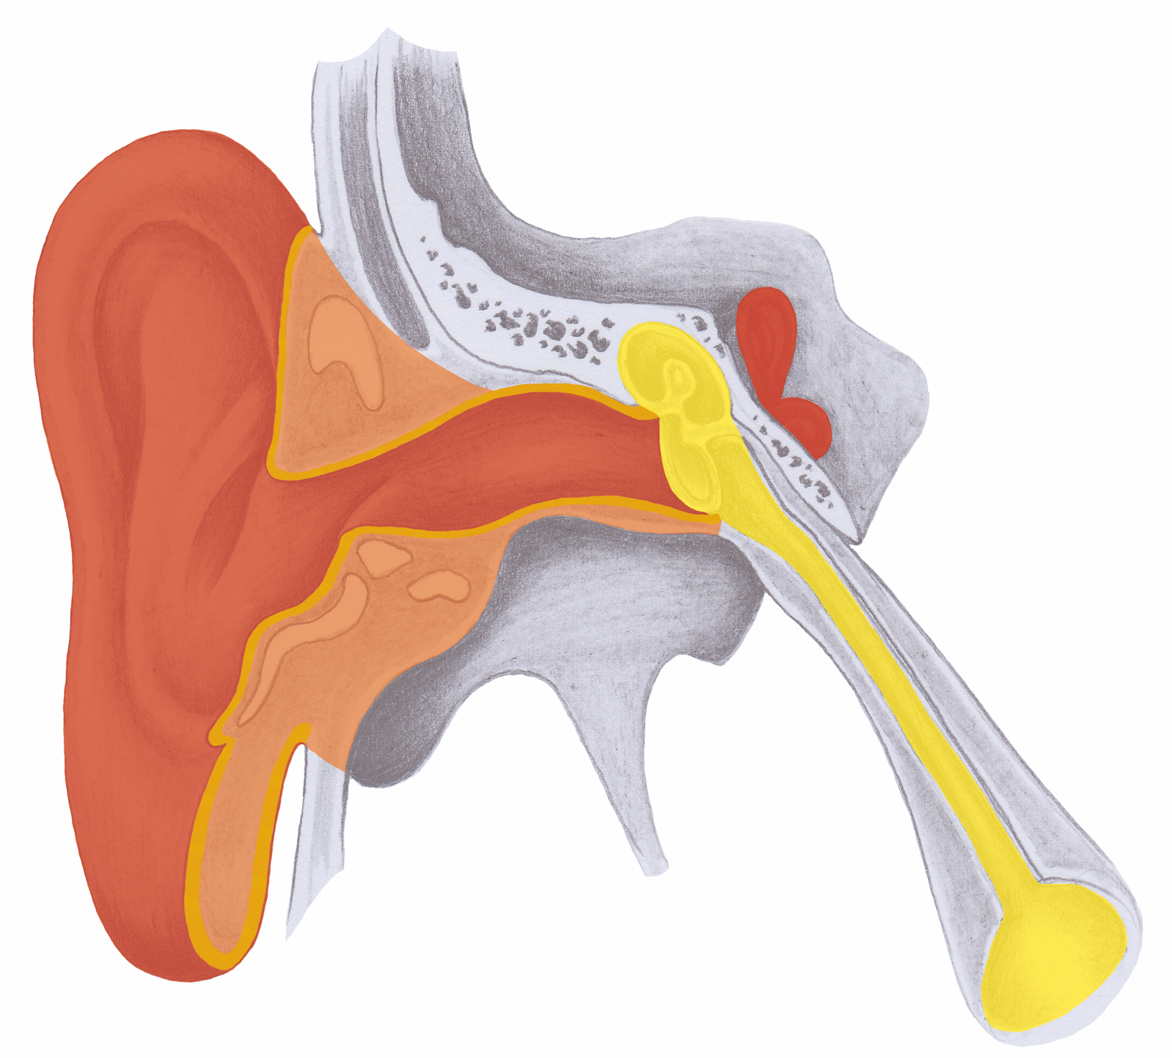
Ear Overview

Slide 3
Outer Ear Canal

Slide 4
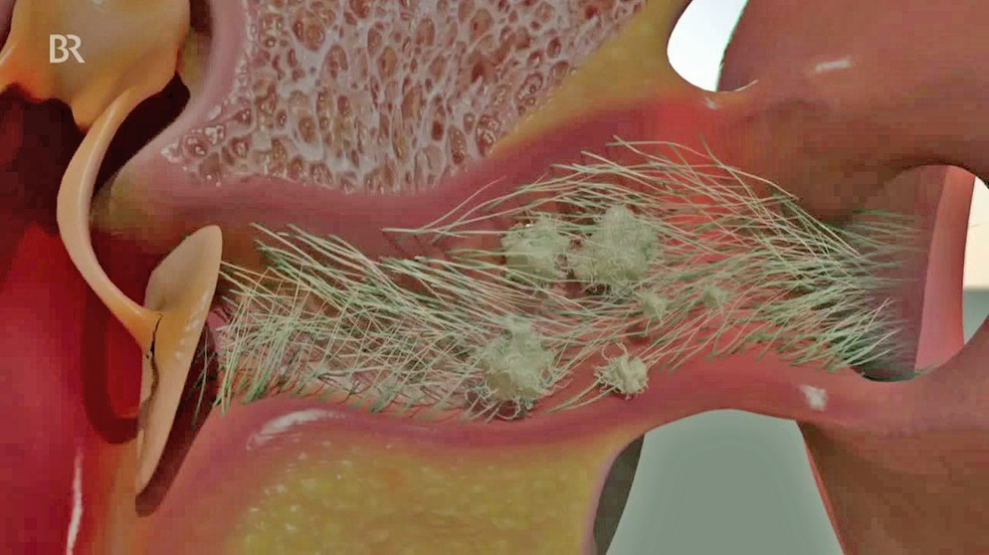
Outer Ear Canal - Cilia

Slide 5
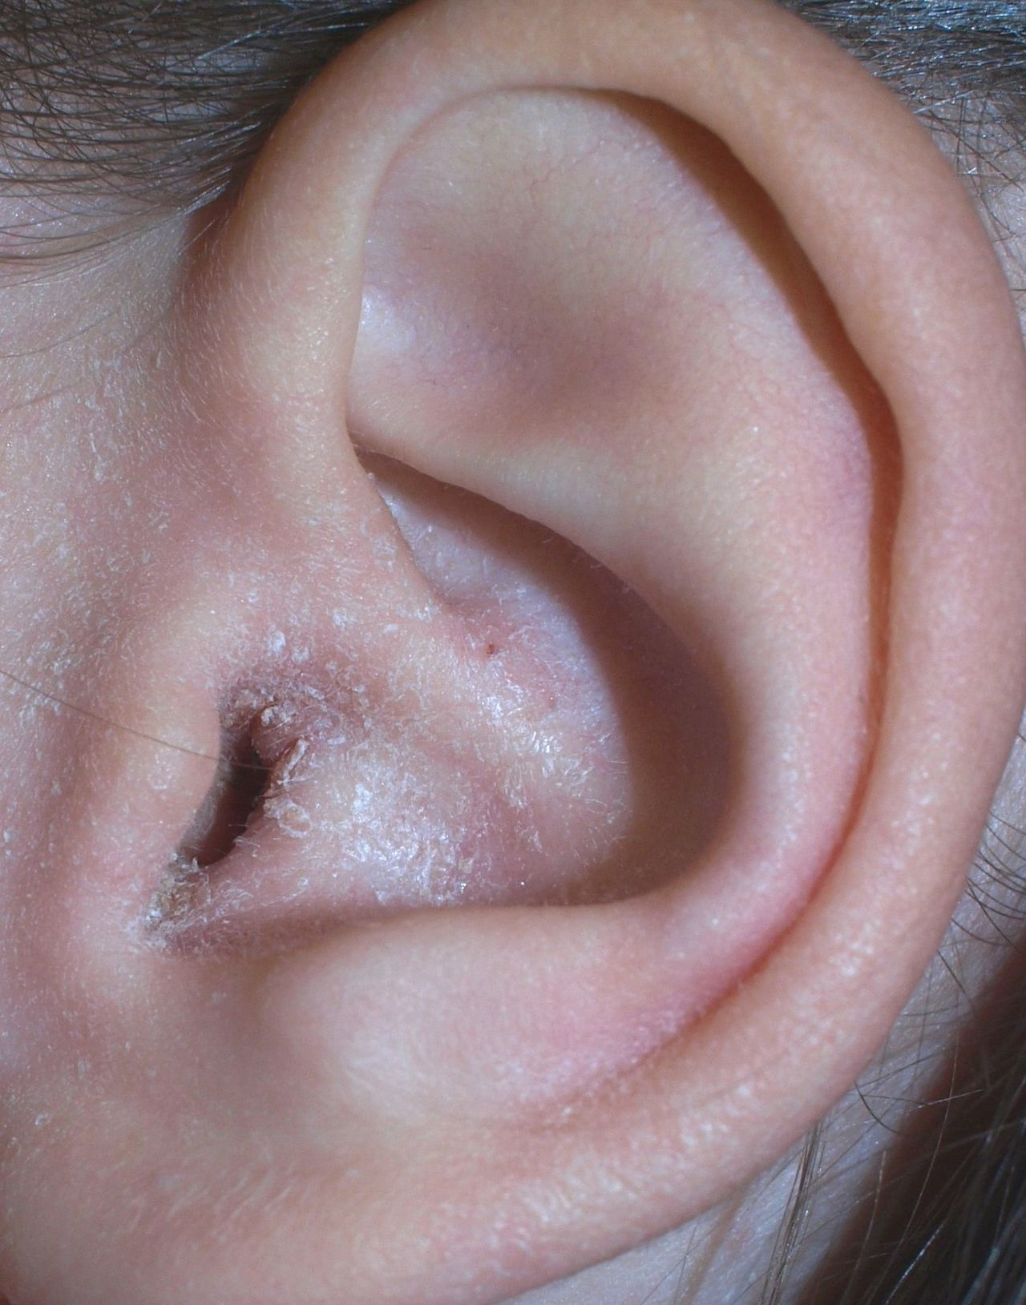
Ear Eczema – Separation Conflict

Slide 6
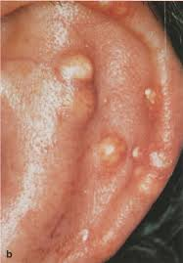
Gouty Tophi Ear: Cartilage (Self-esteem
Conflict) + Active Kidney Collection Tubules

Slide 7
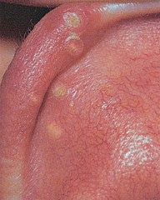
Gouty Tophi Ear: Cartilage (Self-esteem
Conflict) + Active Kidney Collection Tubules

Slide 8
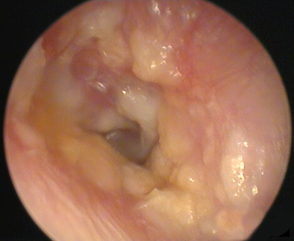
Ear Canal Inflammation: Separation Conflict

Slide 9
Middle Ear

Slide 10
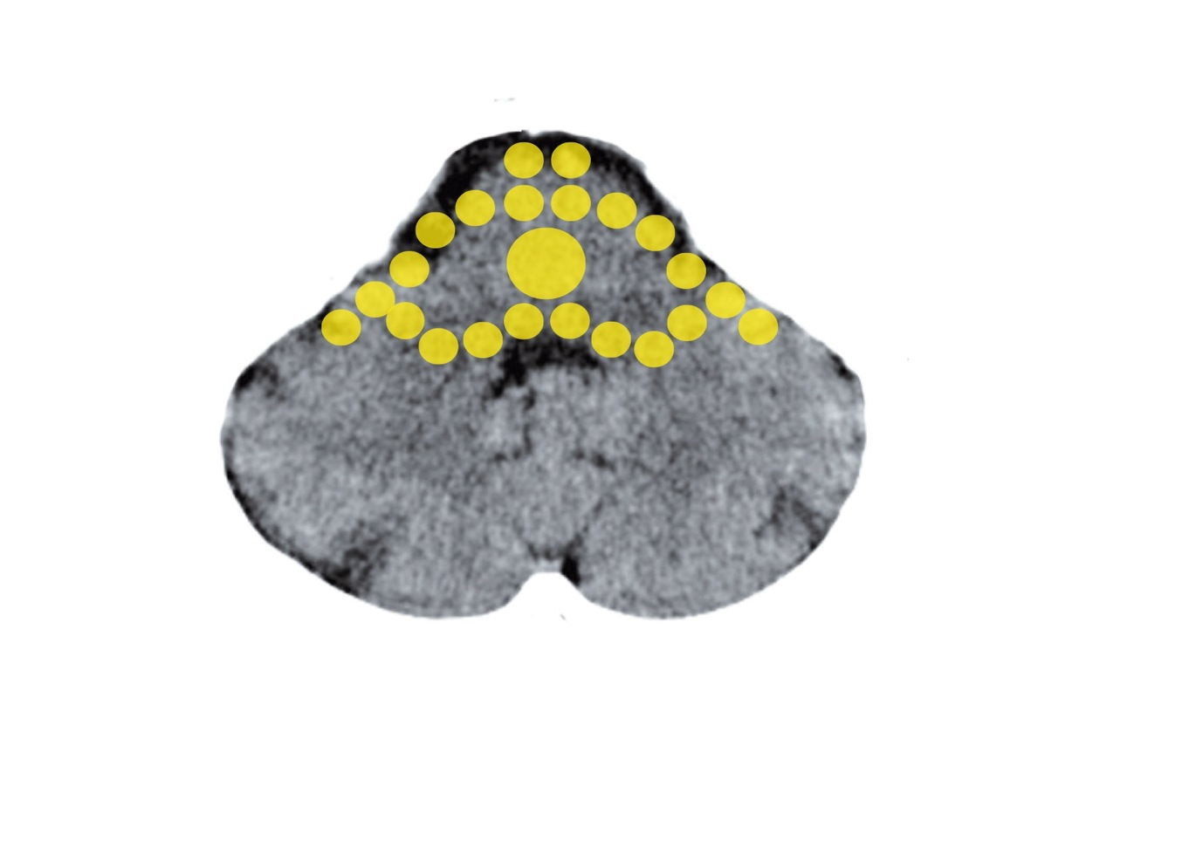
Brain Stem: Middle Ear and Eustachian Tubes
Mittelohr und Tuba eustachii - Stammhirn

Slide 11
Middle Ear Infection

Slide 12
Middle Ear Infection

Slide 13
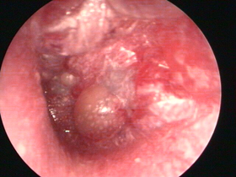
Infected Eardrum

Slide 14
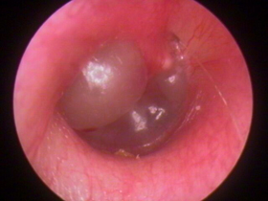
Bulging Eardrum

Slide 15
Inner Ear

Slide 16
Cerebral Cortex: Hearing Folds – Inner Ear
Sensorik

Slide 17
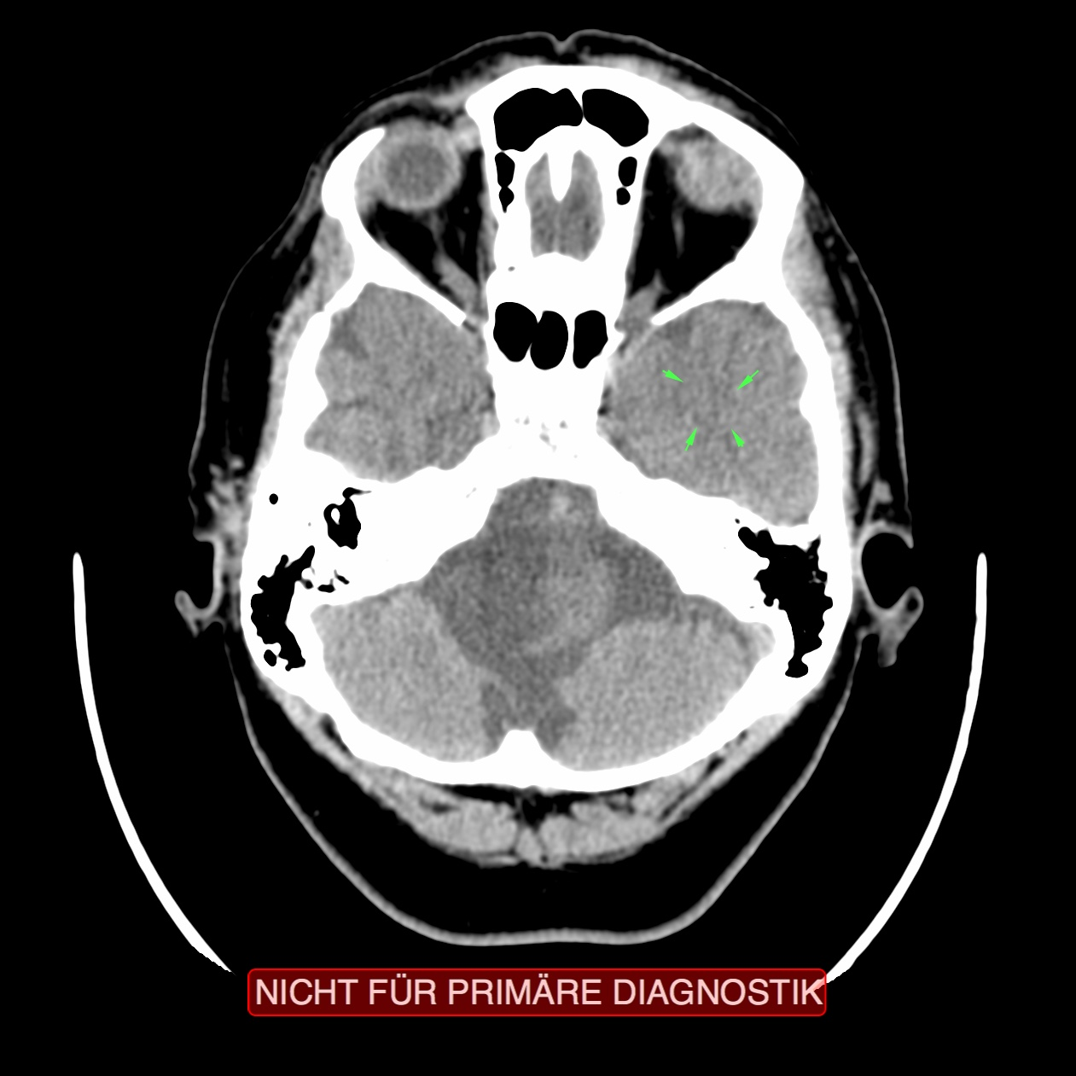
CT: Hearing Folds, Recurring Conflict
Innenohr – Schnecke und Bogengänge

Slide 18
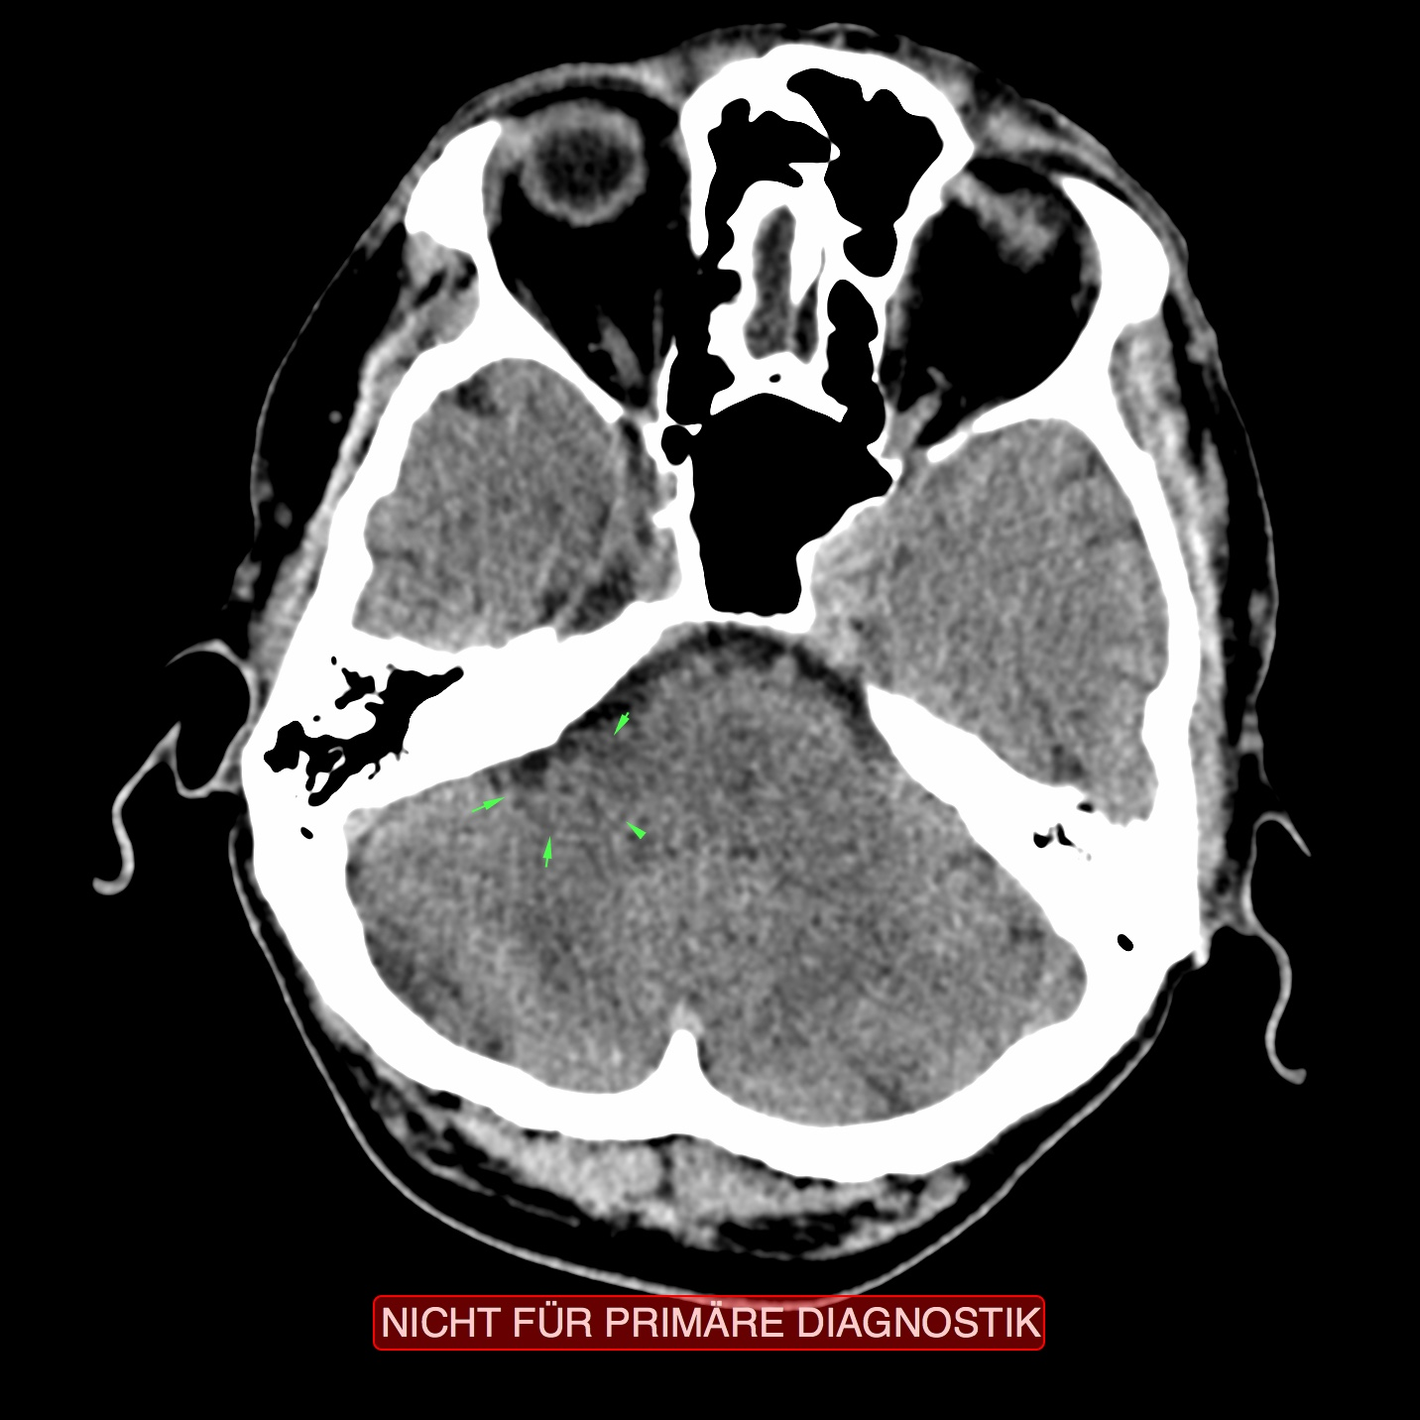
CT: Left Middle Ear, Recurring Conflict
Innenohr – Schnecke und Bogengänge

Slide 19
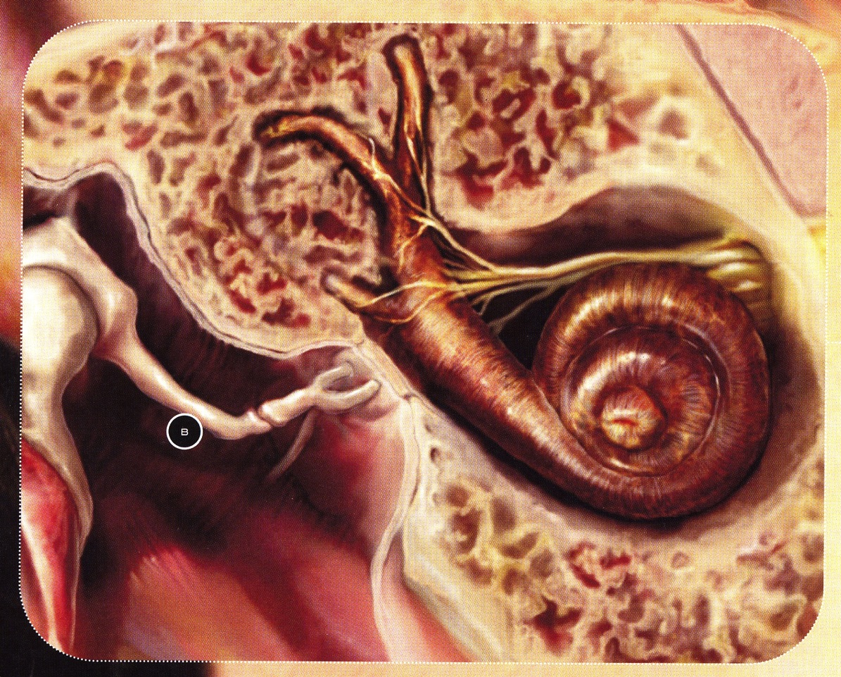
Inner Ear: Cochlea and Semicircular Ducts
Innenohr – Schnecke und Bogengänge

Slide 20
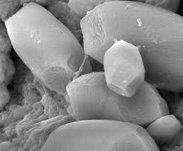
Static Balance CaCO3 Crystals: Otoliths

Slide 21
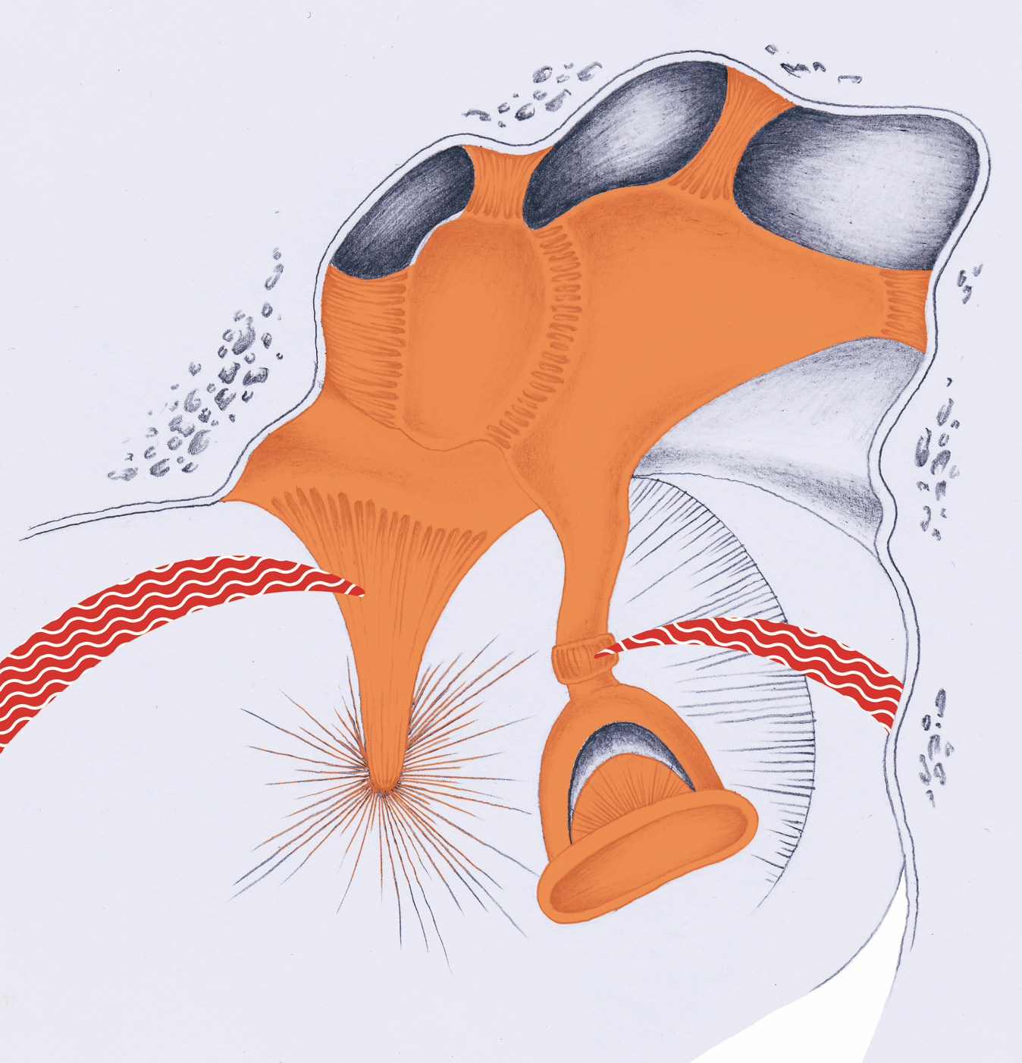
M. stapedius and M. tensor tympani

