Slide 1
Eye

Slide 2
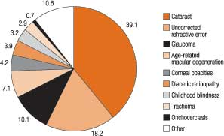
Eye Diseases - Distribution

Slide 3
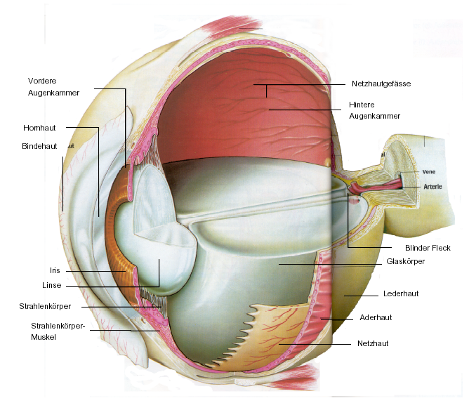

Slide 4
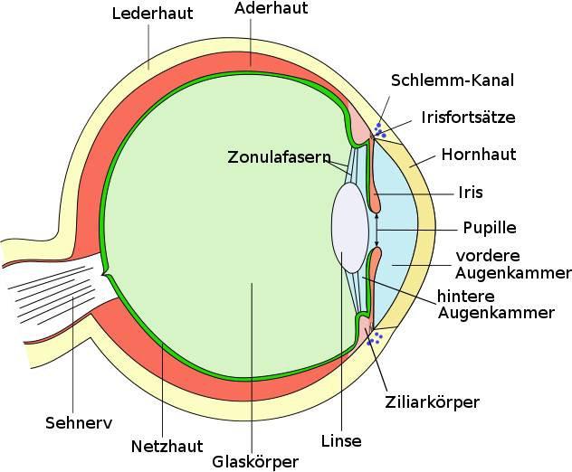

Slide 5
Optic Nerve

Slide 6
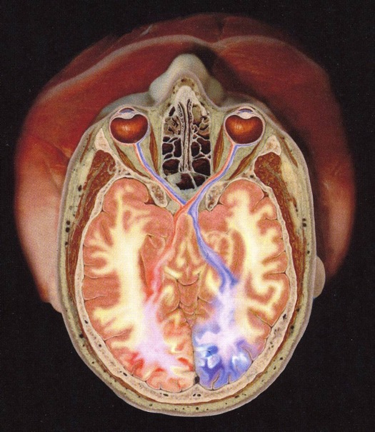
Optic Nerve – Sectional View

Slide 7
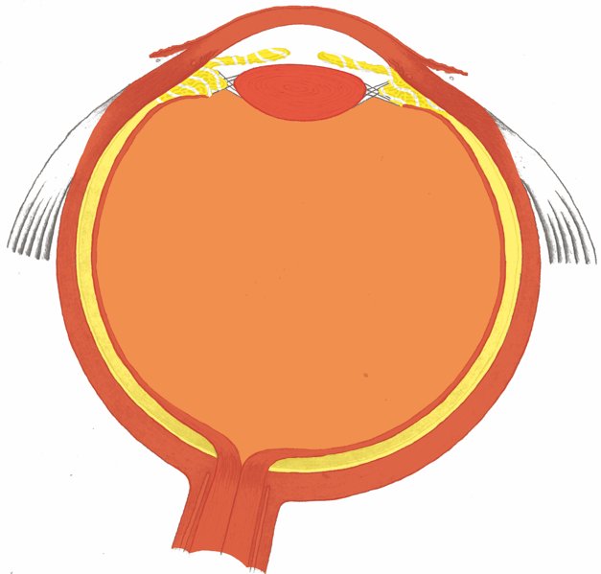
Eye – Germ Layer Assignment

Slide 8
“Eyeball” – Vascular Layer = Uvea

Slide 9
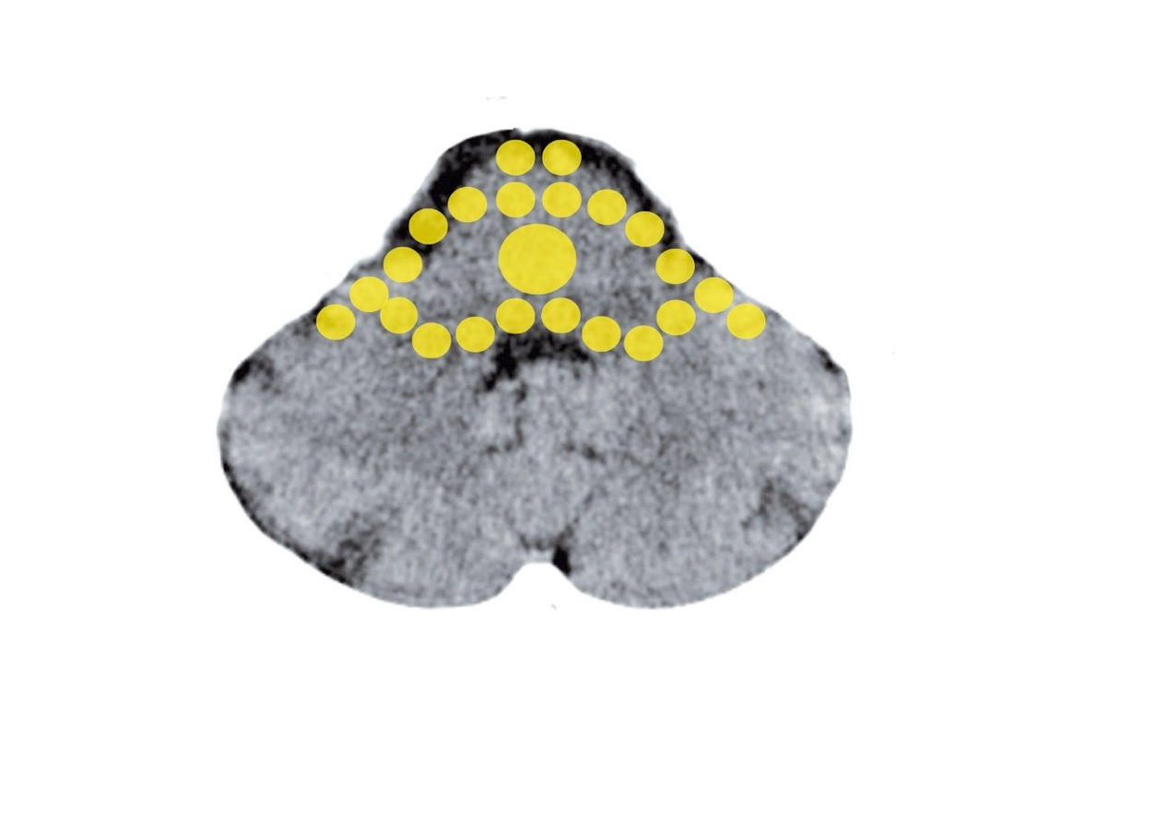
Brainstem – Endoderm: Choroid, Iris
Mittelohr und Tuba eustachii - Stammhirn

Slide 10
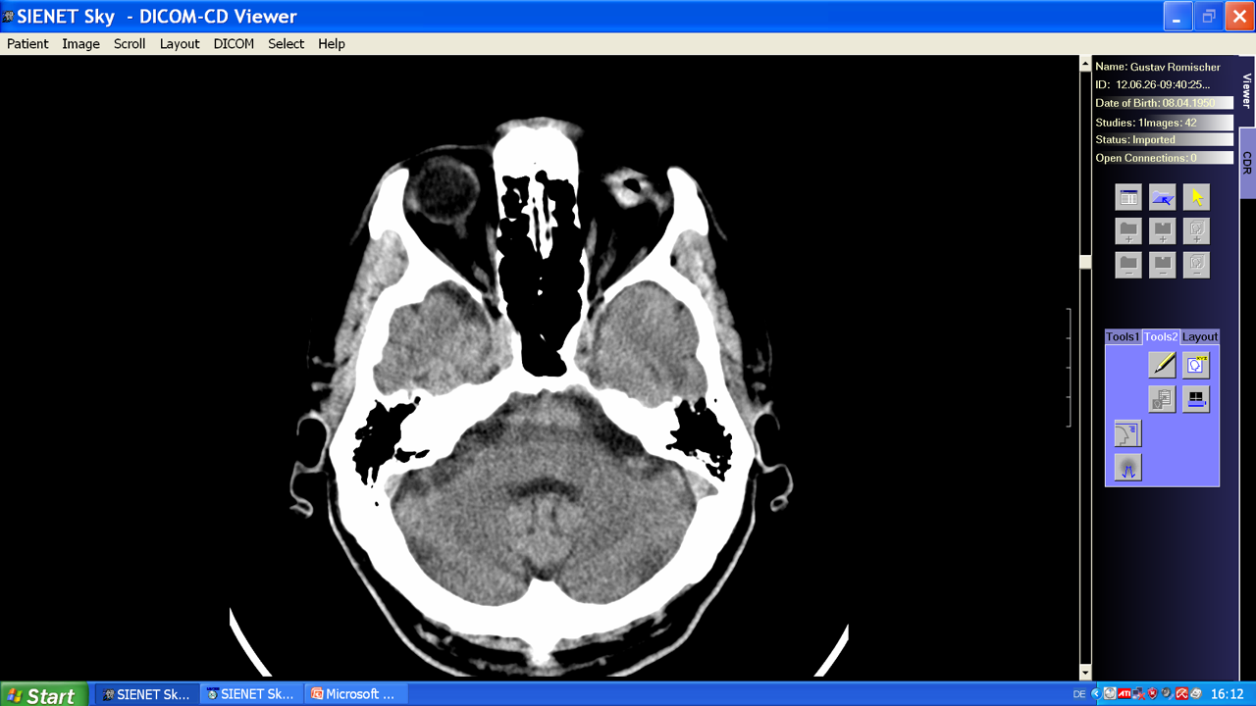
Hamer Focus: Choroid, Recurring Conflict

Slide 11
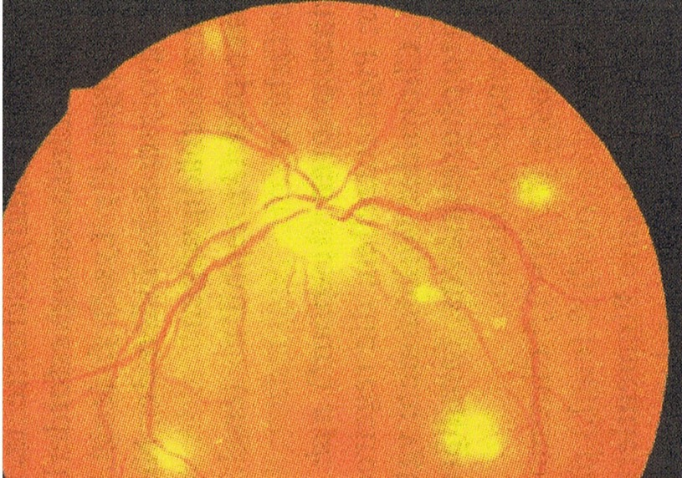
Choroid-TBC
Notes:
11

Slide 12
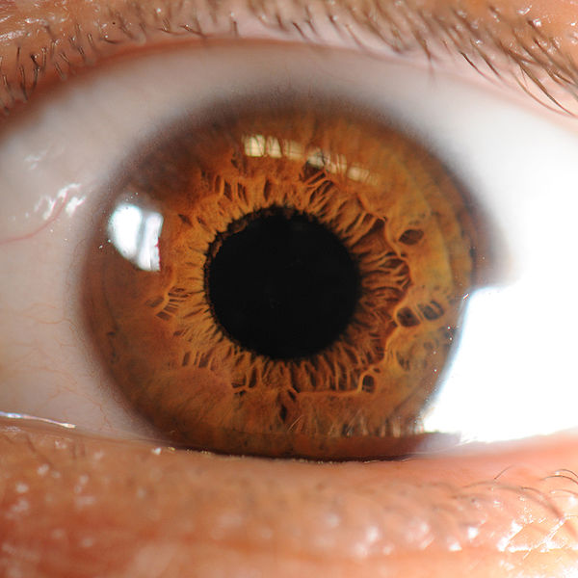
Iris
Notes:
12

Slide 13
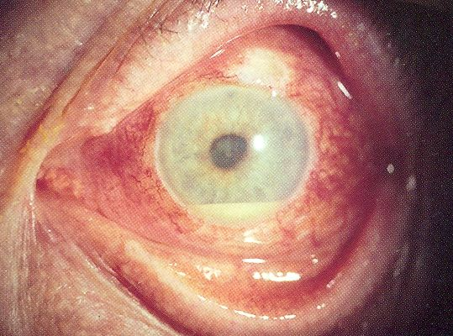
Inflammation of the Iris (Iritis)
Notes:
13

Slide 14
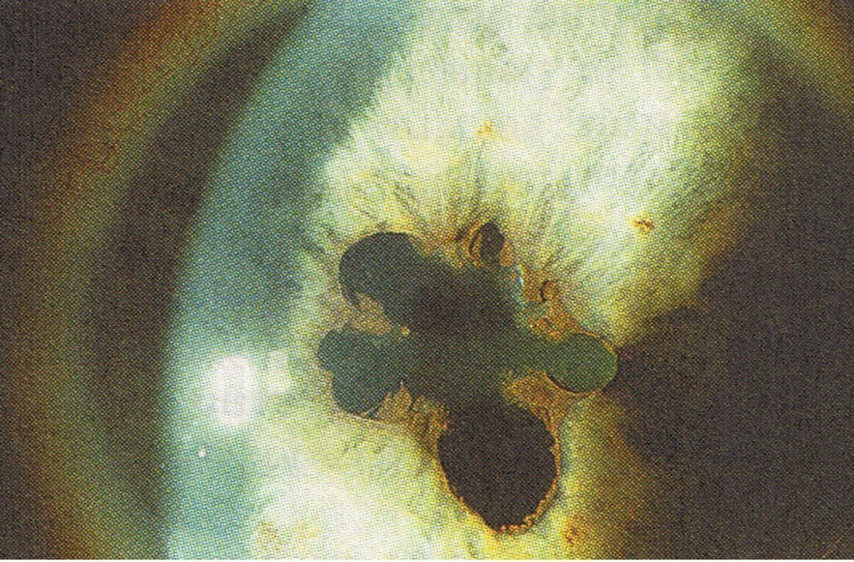
Uveitis
Notes:
14

Slide 15
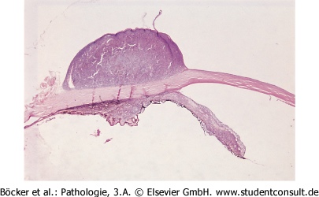
“Melanoma” of the Ciliary Body
Notes:
15

Slide 16
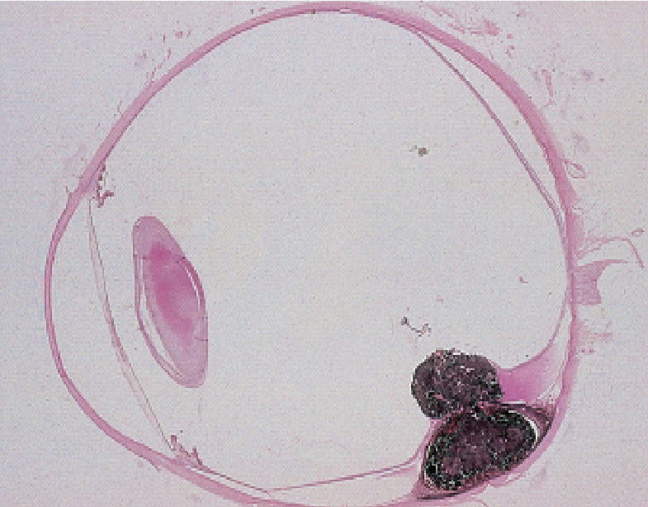
Choroid – “Melanoma”
Notes:
16

Slide 17
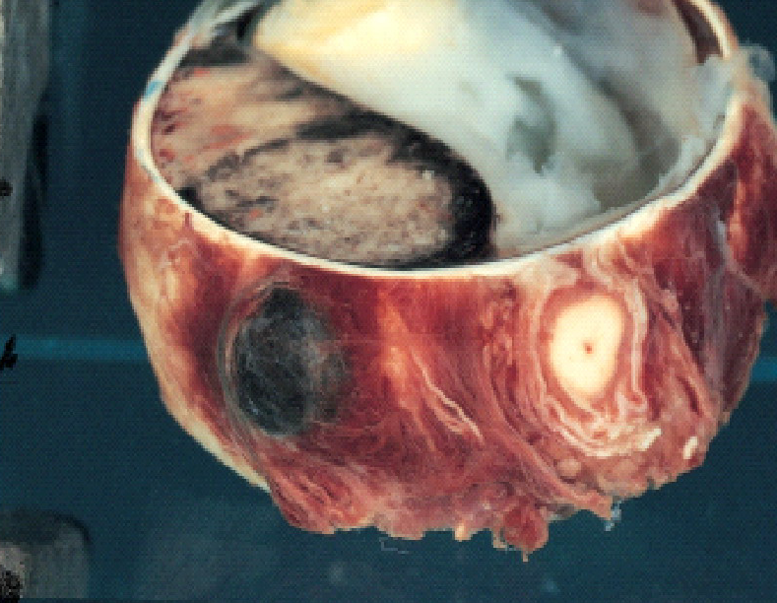
Choroid – “Melanoma”
Notes:
17

Slide 18
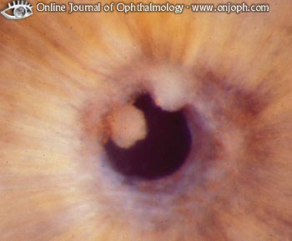
Pupillary Seam Nodules (Sarcoidosis)
Notes:
18

Slide 19
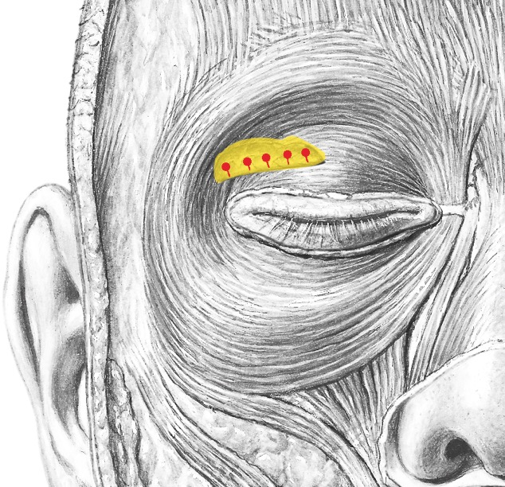
Tear Ducts – Lacrimal Glands

Slide 20
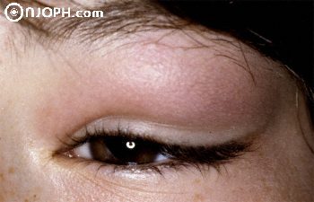
Inflammation of the Tear Ducts

Slide 21
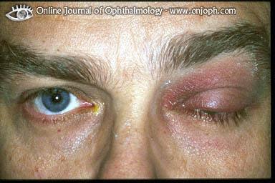
Inflammation of the Tear Ducts

Slide 22
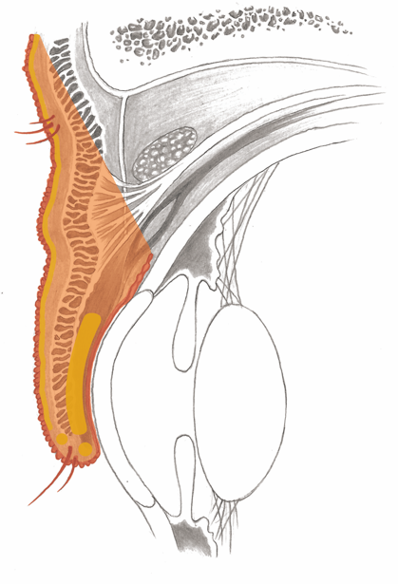
Moll’s, of Zeis and Meibomian Glands

Slide 23
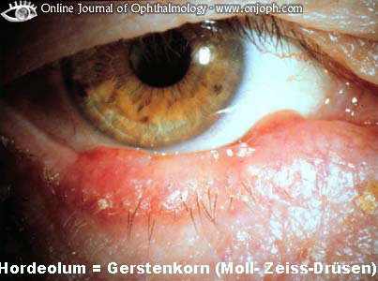
Stye

Slide 24
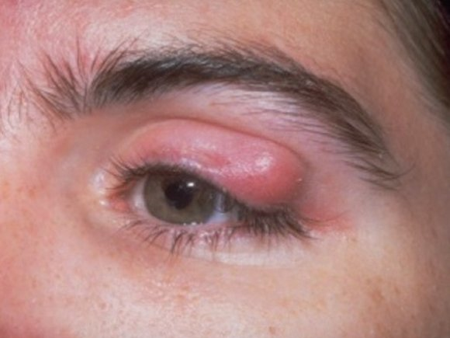
Chalazion

Slide 25
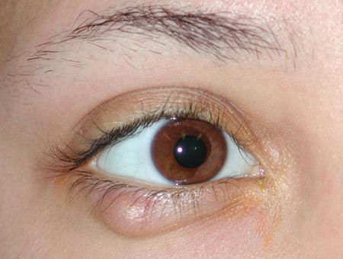
Chalazion

Slide 26
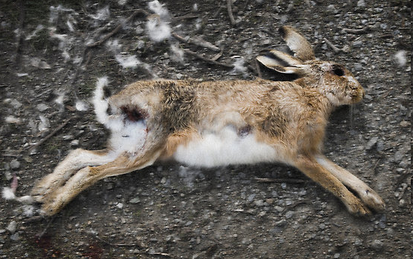

Slide 27
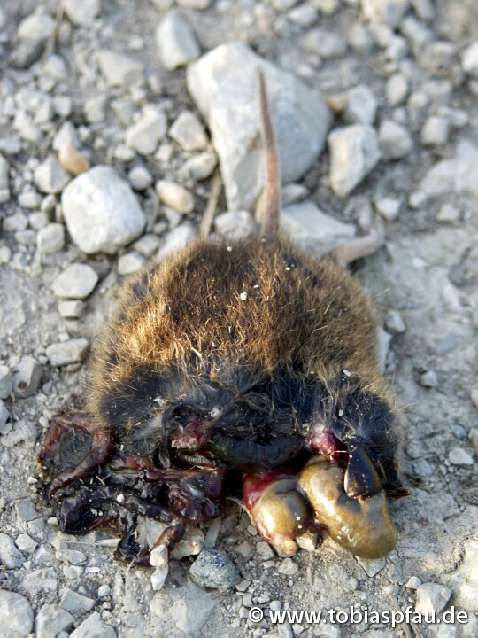

Slide 28
Iris Musculature

Slide 29
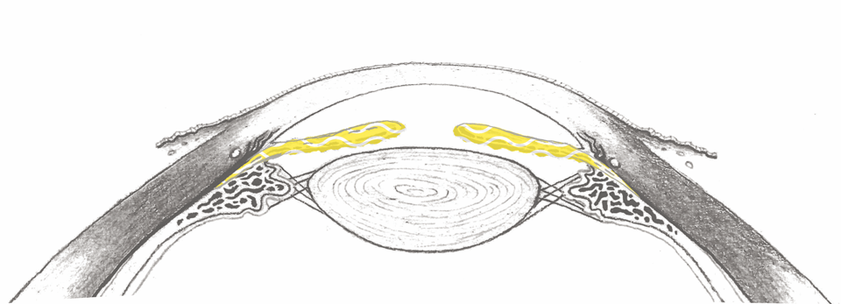
Iris Musculature
= old, intestinal musculature of the eyeball.
Pupil, Lat. Pupilla, literally Little Doll:

Slide 30

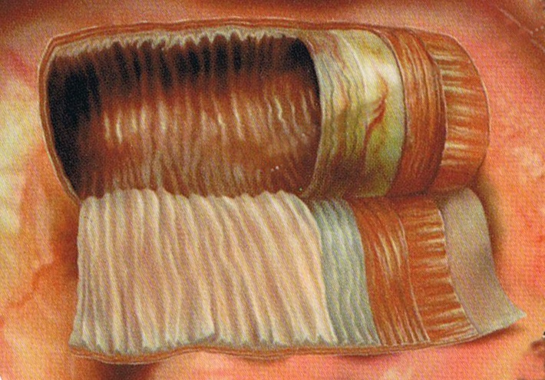
Smooth Musculature – Intestinal Peristalsis Principle

Slide 31
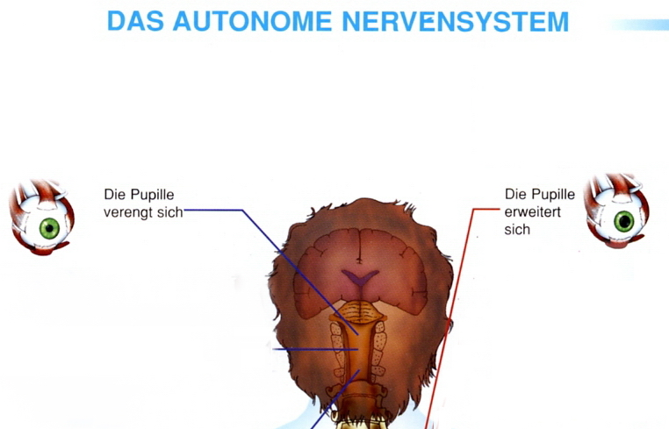
III. Hirnnerv: Irismuskulatur
Parasympaticus-
Aktivität
Sympaticus-
Aktivität
M.sphincter pupillae
M.dilatator pupillae

Slide 32
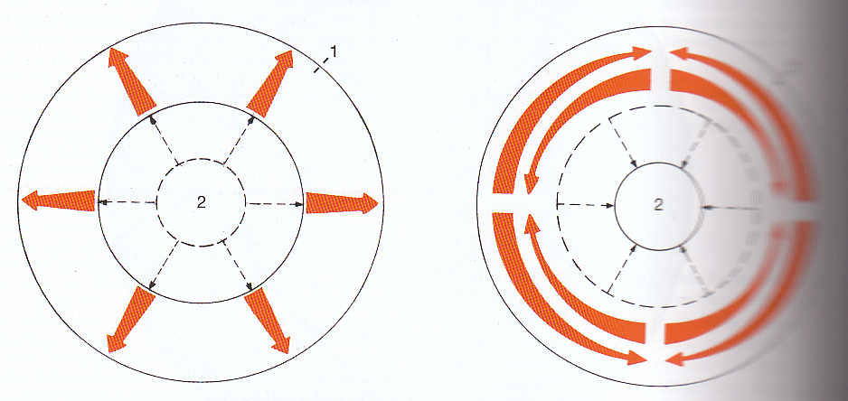
Iris Musculature

Slide 33
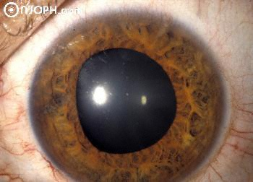
Unevenly Shaped Pupil

Slide 34
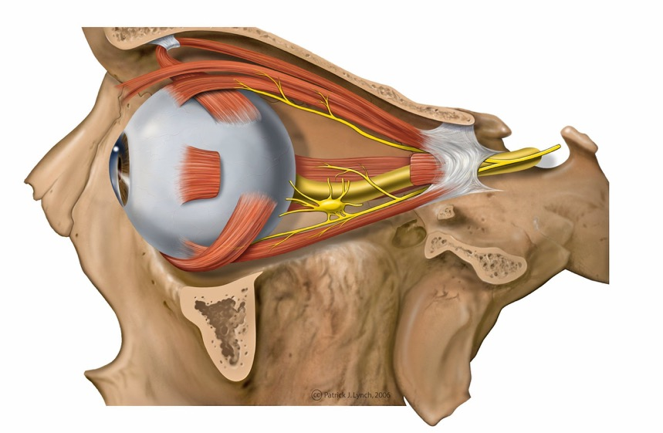
Outer Eye Muscles

Slide 35
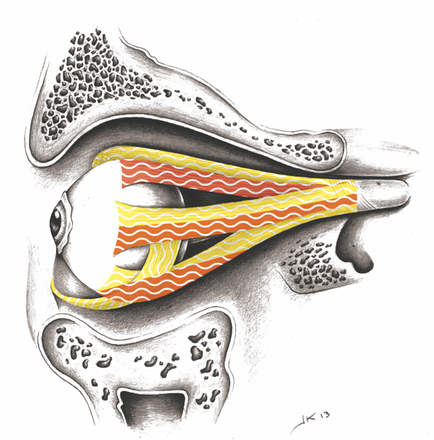
Outer Eye Muscles

Slide 36
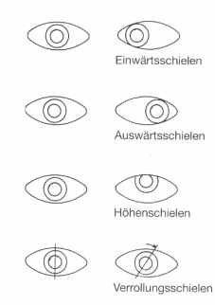
Outer Eye Muscles
Forms of Strabismus: Esotropia/Crossed
Exotropia/Divergent
Hypotropia/Vertical
Cyclotropia/Rolling
Notes:
36

Slide 37

Strabismus - Esotropia

Slide 38
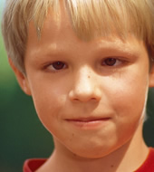
Strabismus - Esotropia

Slide 39
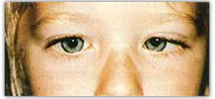
Strabismus – Esotropia

Slide 40
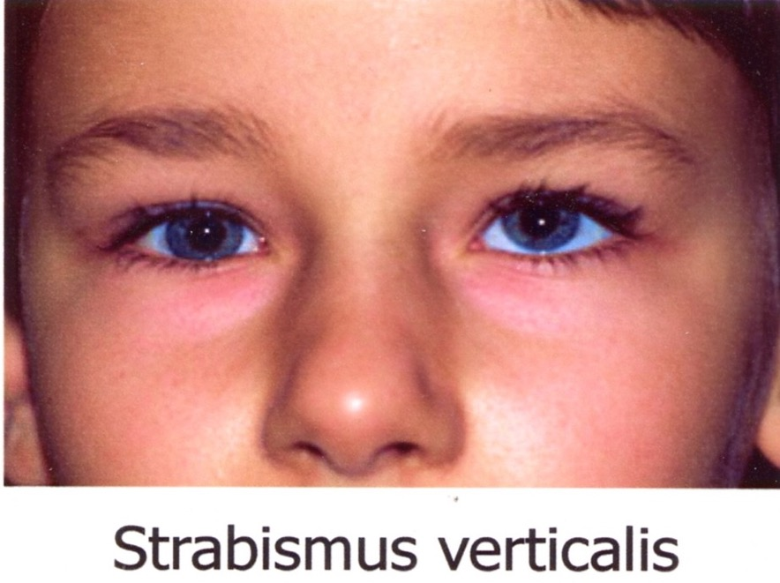
Strabismus - Hypertropia

Slide 41

Strabismus in CM – “Occlusion therapy”

Slide 42
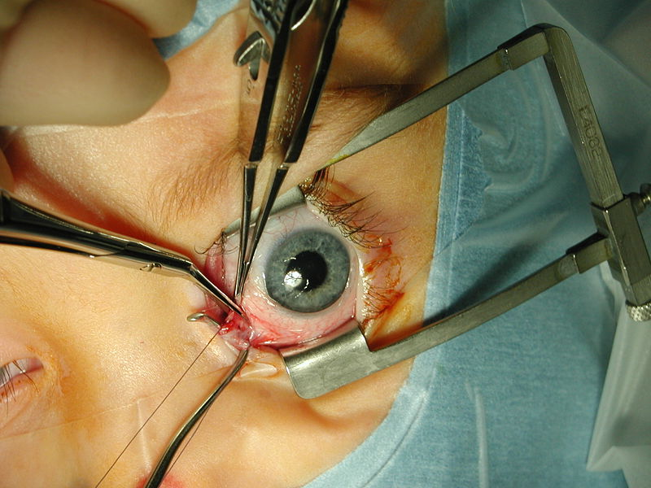
OP – on the M. rectus medialis

Slide 43
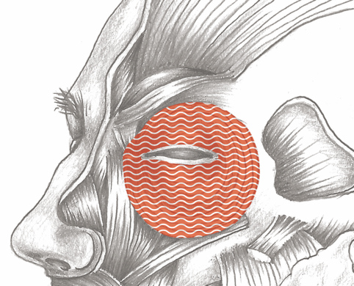
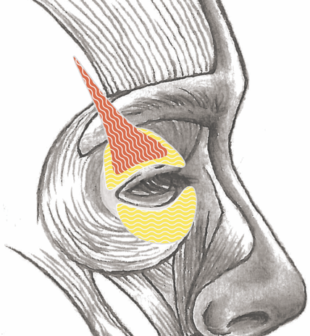
Eyelid – Opening and Closing Muscles

Slide 44
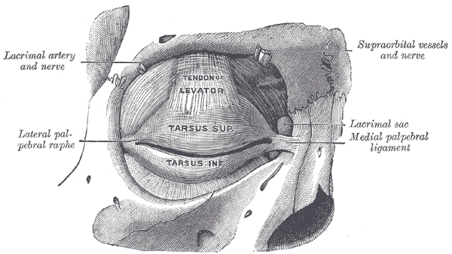
Opening Muscle – Tarsal M. (smooth M.)

Slide 45
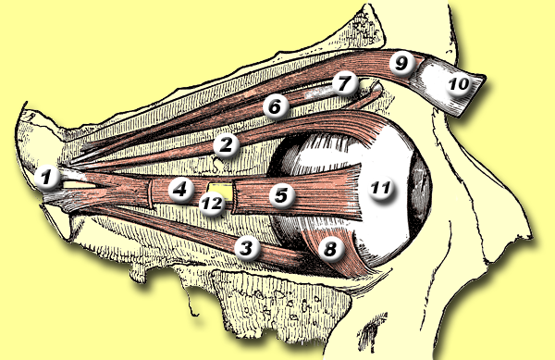
Opening Muscle – M. levator palpebrae (striated. M.)

Slide 46
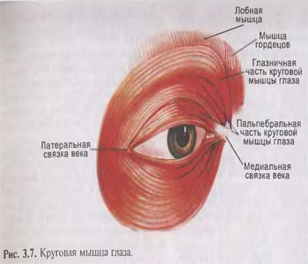
Closing Muscle – M. orbicularis (striated M.)

Slide 47
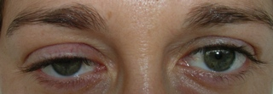
Drooping Eyelid (Ptosis) – M. levator palpebrae
Also when tired or after thyroid operation (both eyes). This is due to a general reduction in sympathetic nervous activity!
Notes:
47

Slide 48
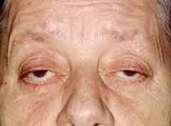
Drooping Eyelids (Ptosis) – M. levator palpebrae
Notes:
48

Slide 49
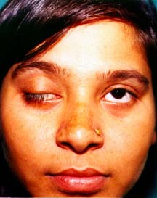
Drooping Eyelid (Ptosis)
Notes:
49

Slide 50
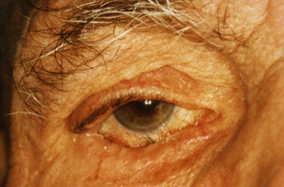
Inverted Eyelid (Entropion, Trichiasis)

Slide 51
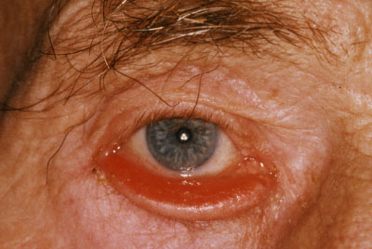
Outward-Turned Eyelid (Ectropium)

Slide 52
Lacrimal Gland Excretory Ducts (Tear Duct)
Notes:
52

Slide 53
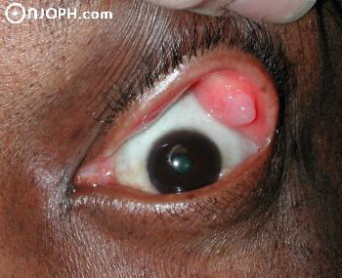
Lacrimal Gland Cyst from a
Narrowing of the Excretory Ducts

Slide 54
Eyelid – Subcutaneous Fatty Tissue

Slide 55
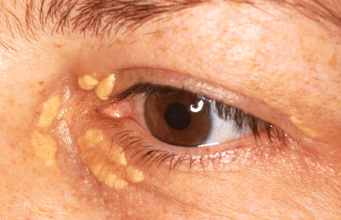
Xanthelasma

Slide 56
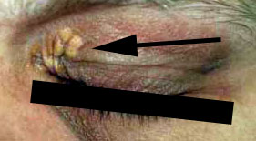
Xanthelasma

Slide 57

Vitreous Body

Slide 58

Fear-of-rear-attack – Attack from Behind (Neck)
Notes:
58

Slide 59
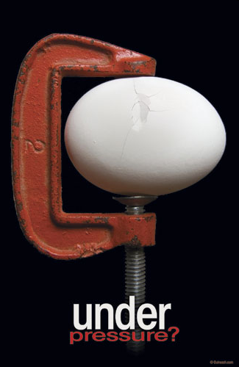
Under Pressure
Notes:
59

Slide 60

Under Pressure
Notes:
60

Slide 61

Anterior and Posterior Chambers of the Eyewall

Slide 62

Intraocular Pressure - Measurement

Slide 63
Optic Nerve

Slide 64

Glaucoma Papille
Notes:
64

Slide 65

SBS of the Optic Nerve –
Conflict: I am so annoyed!

Slide 66

Vitreous Body – Cyst

Slide 67

Glaucoma “Wearing Blinders” Phenomenon
Notes:
67

Slide 68

Glaucoma
Notes:
68

Slide 69

Kondensation von Collagen
Notes:
69

Slide 70

Collagen Condensation
Notes:
70

Slide 71

Floaters = Collagen Condensation
Notes:
71

Slide 72
Overview – Retina

Slide 73

Cerebral Cortex – Visual Cortex
(inside Vitreous Body, outside Retina)
Notes:
73

Slide 74

CT: Left Retinal Halves, Active Conflict

Slide 75

CT: Right Retinal Halves, Active Conflict

Slide 76

CT: Left Retinal Halves, Recurring Conflict

Slide 77

Ophthalmoscopy – Optic Nerve – Macula
Notes:
77

Slide 78

Retinal Detatchment
Notes:
78

Slide 79

Retinal Detatchment
Notes:
79

Slide 80

Retinal Hole (Detachment)

Slide 81

Retinal Hole (Detachment)
Notes:
81

Slide 82

Retinoblastoma
Notes:
82

Slide 83

Vitreous Traction

Slide 84

Vitreous Traction

Slide 85

Optical Coherence Tomography (OCT)

Slide 86

Retinal Traction
Notes:
86

Slide 87
Macula
Notes:
87

Slide 88

Healthy Eye
Notes:
88

Slide 89

Visual Field with Macular Degeneration
Notes:
89

Slide 90

Visual Field with Macular Degeneration
Notes:
90

Slide 91

Dry Macular Degeneration – Drusen

Slide 92

Dry Macular Degeneration – Drusen

Slide 93

Cystoid Macular Edema

Slide 94

Guilt, Shame, Disgrace
Notes:
94

Slide 95

Overview – Back of the Retina

Slide 96

Field of View with Retinitis pigmentosa

Slide 97
Visual Separation Conflict
Longing, Loneliness

Slide 98

Conjunctivitis

Slide 99

Conjunctivitis

Slide 100

Conjunctival Bleeding

Slide 101

Molluscum Contagiosum

Slide 102

Molluscum Contagiosum

Slide 103

Corner of the Eye Wart (Caruncle papilloma)

Slide 104

Wart (Papilloma) of the Conjunctiva

Slide 105

Pinguecula

Slide 106

Pterygium

Slide 107

“Eye Freckle” Iris Nevus

Slide 108

Cornea

Slide 109

Deep Corneal Ulcer (Keratitis)

Slide 110

Dermal Inflammation

Slide 111

Corneal Ulcer with Conjunctivitis

Slide 112

Thinning of the Cornea (Keratoconus)

Slide 113
Lens

Slide 114

Clouding of the Lenses – Cataracts

Slide 115

Clouding of the Lenses – Cataracts

Slide 116
Near-sightedness - Myopia

Slide 117

Adaptation

Slide 118

Axial Near-sightedness – Eyeball Too Long
Notes:
118

Slide 119

Near-sightedness – Outer Eye Muscles
Notes:
119

Slide 120

Near-sightedness – Outer Eye Muscles
Notes:
120

Slide 121

Near-sightedness – Outer Eye Muscles
Notes:
121

Slide 122

Refractive Near-sightedness – Ciliary Muscle

Slide 123

Refractive Near-sightedness – Ciliary Muscle
Notes:
123

Slide 124

Refractive Near-sightedness – Ciliary Muscle

Slide 125
Thinning of the Cornea (Keratoconus)

Slide 126
Far-sightedness
Notes:
126

Slide 127

Far-sightedness – Eyeball Too Short
Notes:
127

Slide 128

Far-sightedness Due to Lens Stiffening
Notes:
128

Slide 129
Thanks to Kwesi Anan Odum
Specialist for Eye Ophthalmology, META-Medicine
Lüscher Regulation Psychology
Penta Design, NLP Practitioner (DVNLP)
Energetic Information Medicine
GoMedus Gesundheitszentrum Berlin
Kurfürstendamm 33
10719 Berlin
Tel. 0049 (0) 30 322923300
Mobil. 0049(0) 1776335087
Fax. 0049(0) 30 322923333
Email. metadoctor@t-online.de
Notes:
129

